Slide 1
A Survey of Inverse Reinforcement Learning: Challenges, Methods and Progress
Prashant Doshi
Saurabh Arora

Slide 2
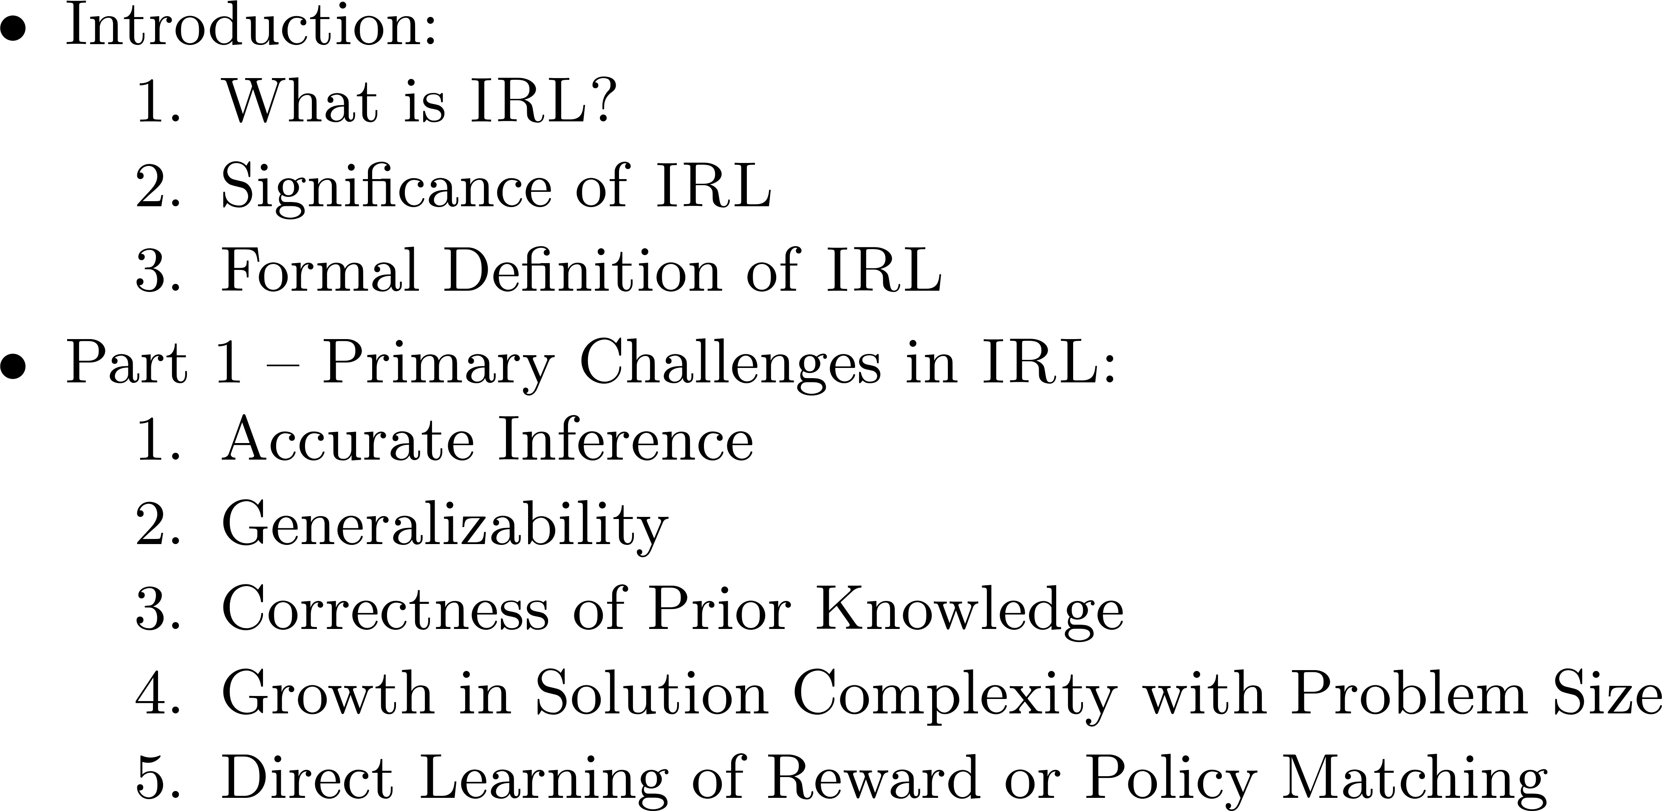
Agenda

Slide 3
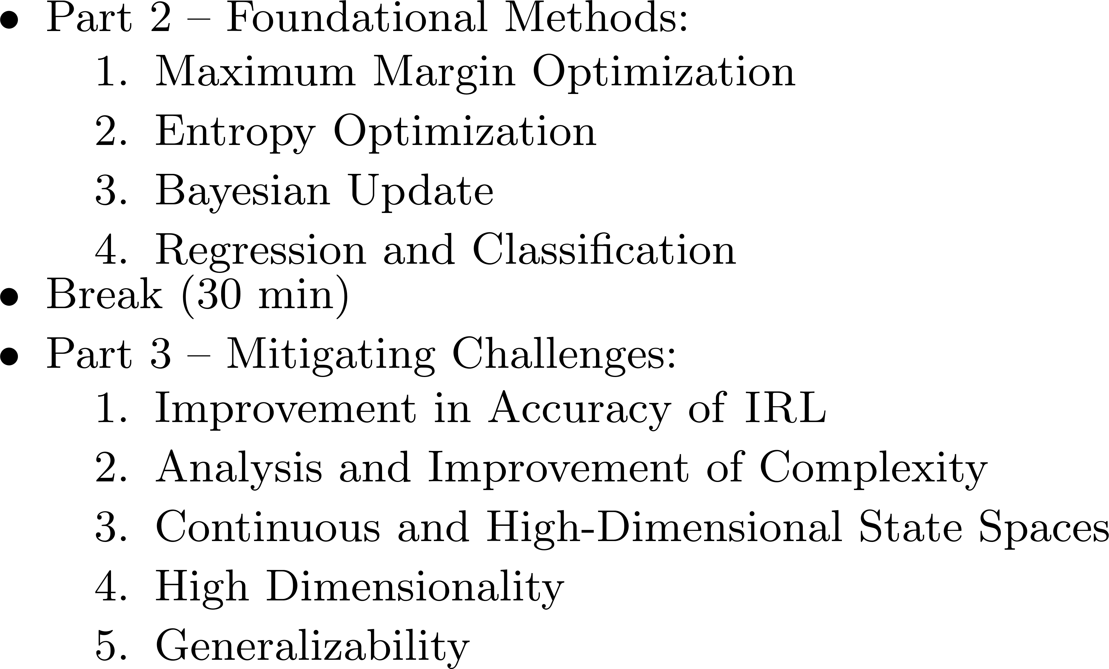
Agenda

Slide 4
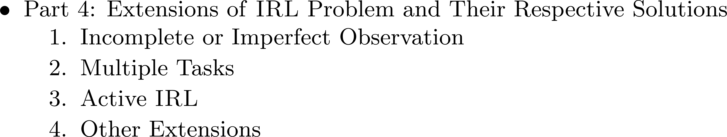
Agenda

Slide 5
Introduction
What is IRL?
Significance of IRL
Formal Definition IRL

Slide 6
What is IRL?
Given: observations of the behavior of an agent engaged in a well-defined task. The observations are in the form of trajectories of state-action pairs.
Find: reward function of the agent

Slide 7
What is IRL?: Lane merge self driving
Observing the behavior of an anonymous driver (expert)
in merging lane

Slide 8
What is IRL?: Lane merge self driving
Processing information required for inferring preferences of expert

Slide 9
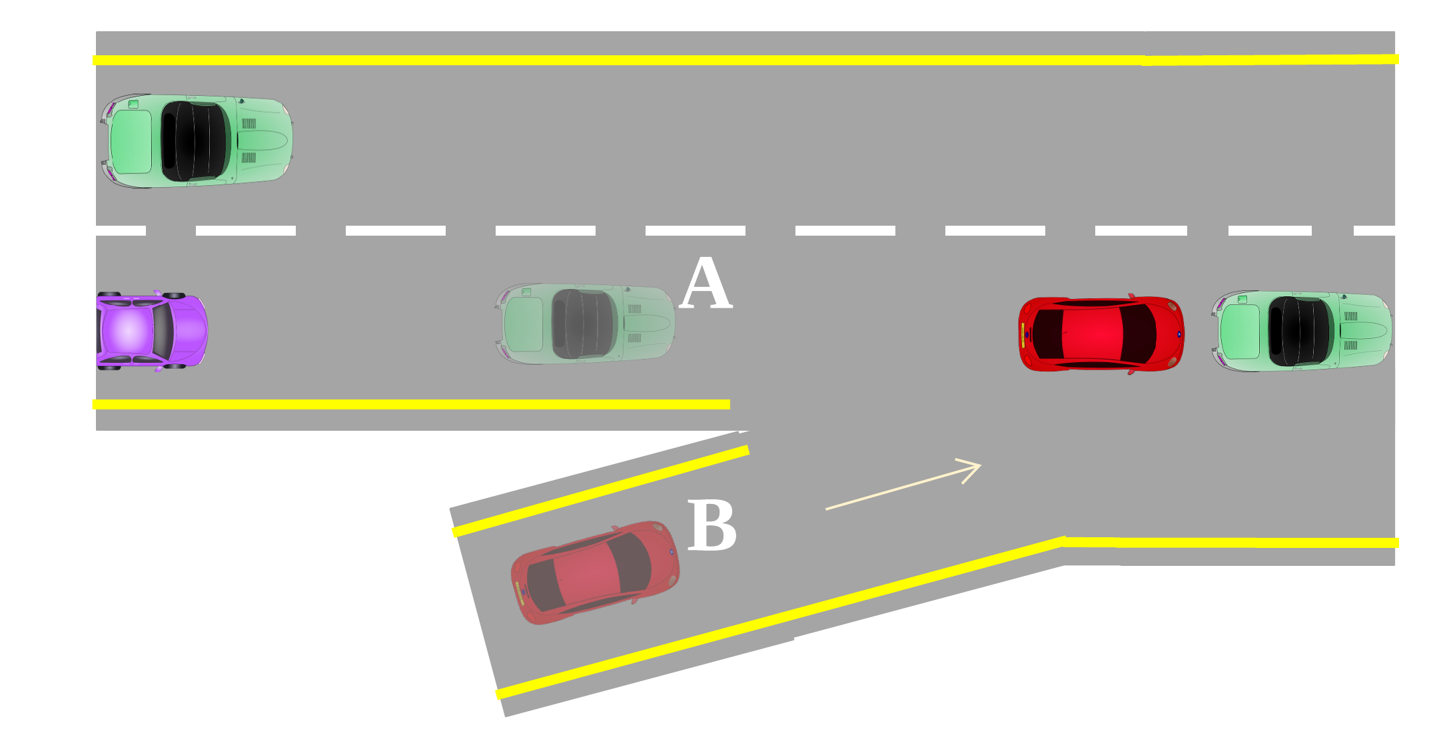
What is IRL?: Lane merge self driving
Learner Car B infers the preferences of Car A as the reward function
B can use the function for merging without collision

Slide 10
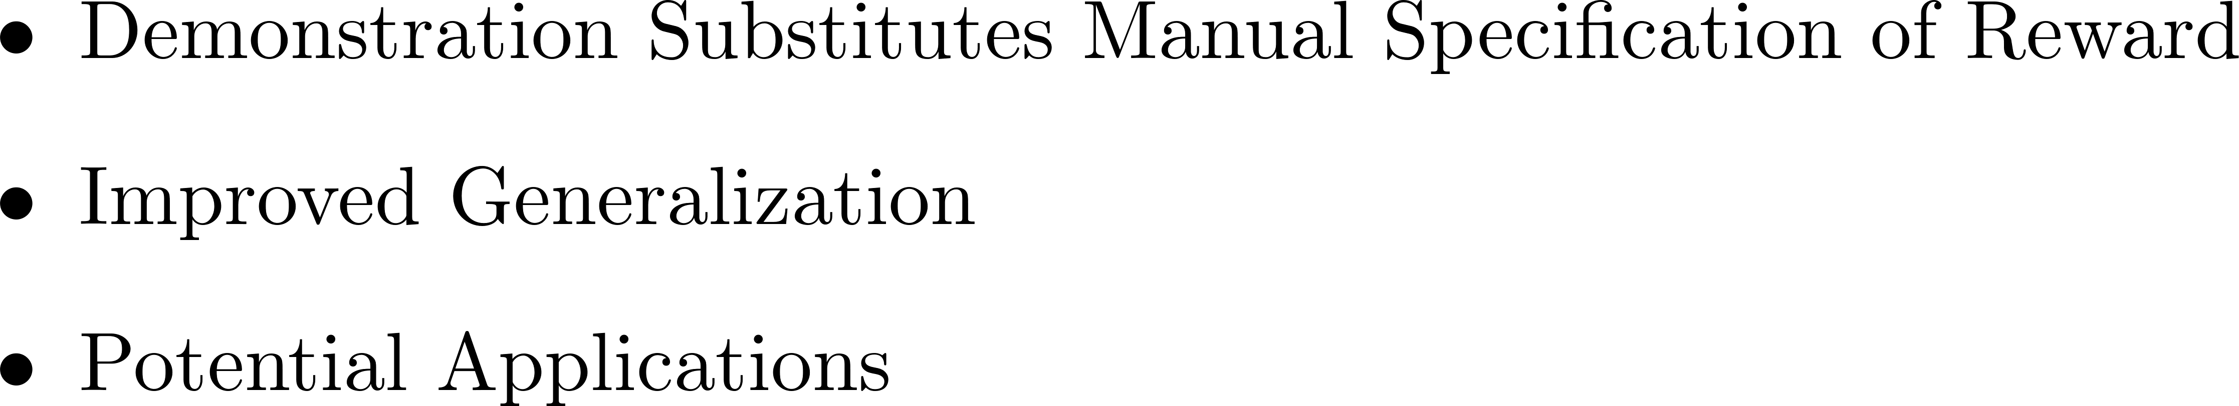
Significance of IRL

Slide 11
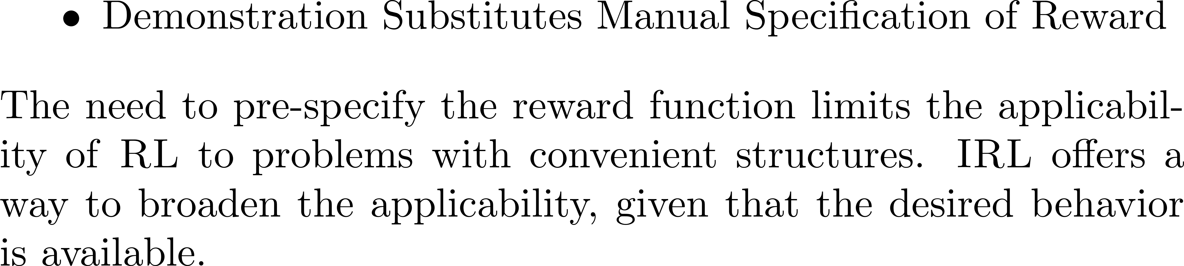
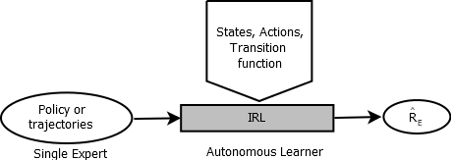
Significance of IRL

Slide 12

Significance of IRL
Reinforcement learning for helicopter maneuvering [13]

Slide 13
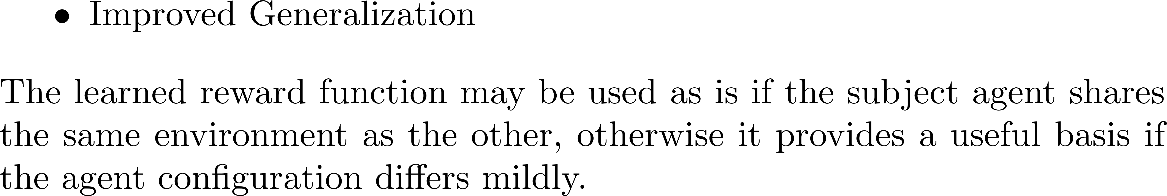
Significance of IRL

Slide 14
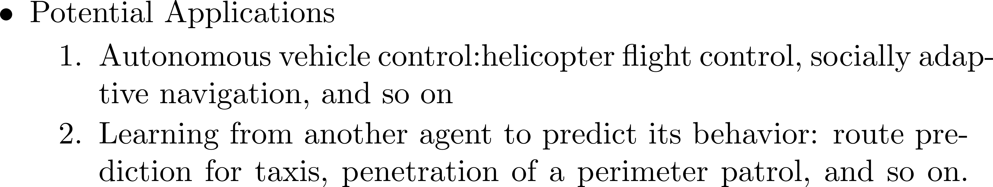
Significance of IRL

Slide 15
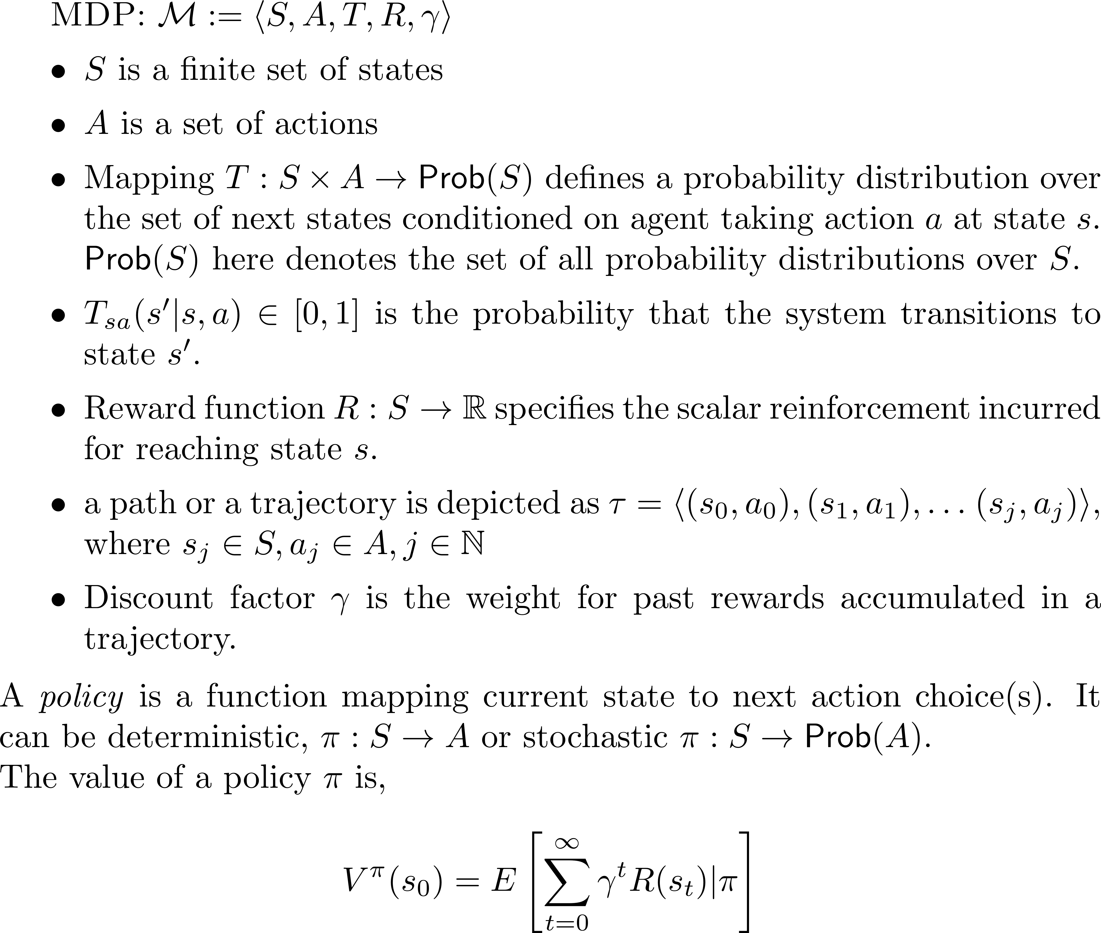
Formal Definition of IRL : Preliminaries

Slide 16
Formal Definition of IRL : Preliminaries

Slide 17
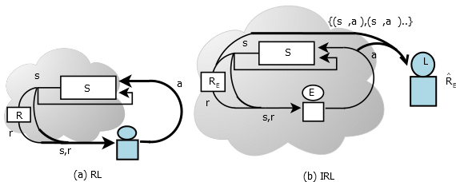
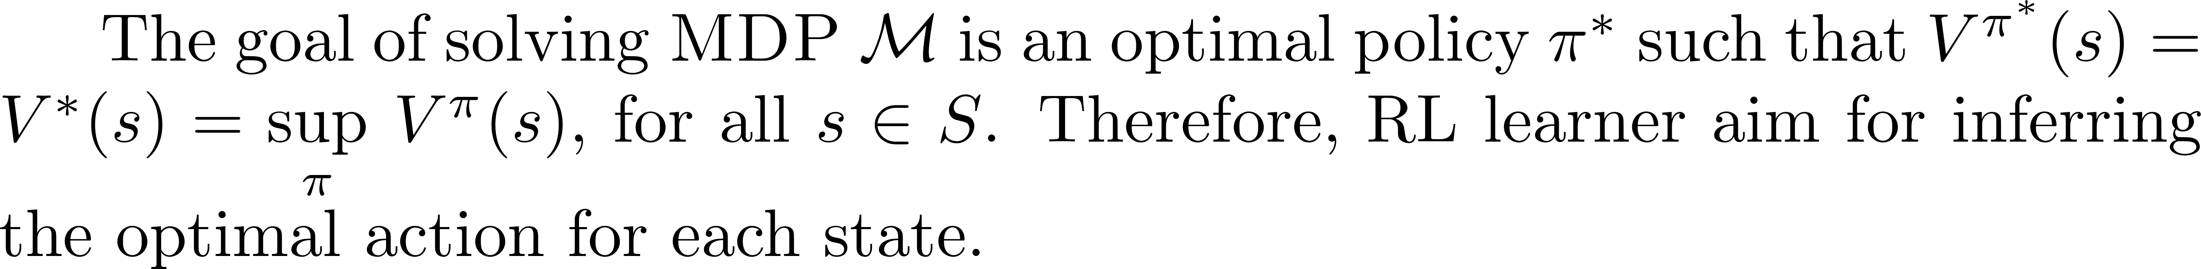
Formal Definition of IRL: Knowing RL

Slide 18
Formal Definition of IRL

Slide 19
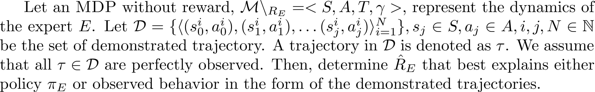
Formal Definition of IRL

Slide 20
Part 1 -- Primary Challenges in IRL
Accurate Inference
Generalizability
Correctness of Prior Knowledge
Growth in Solution Complexity with Problem Size
Direct Learning of Reward or Policy Matching

Slide 21
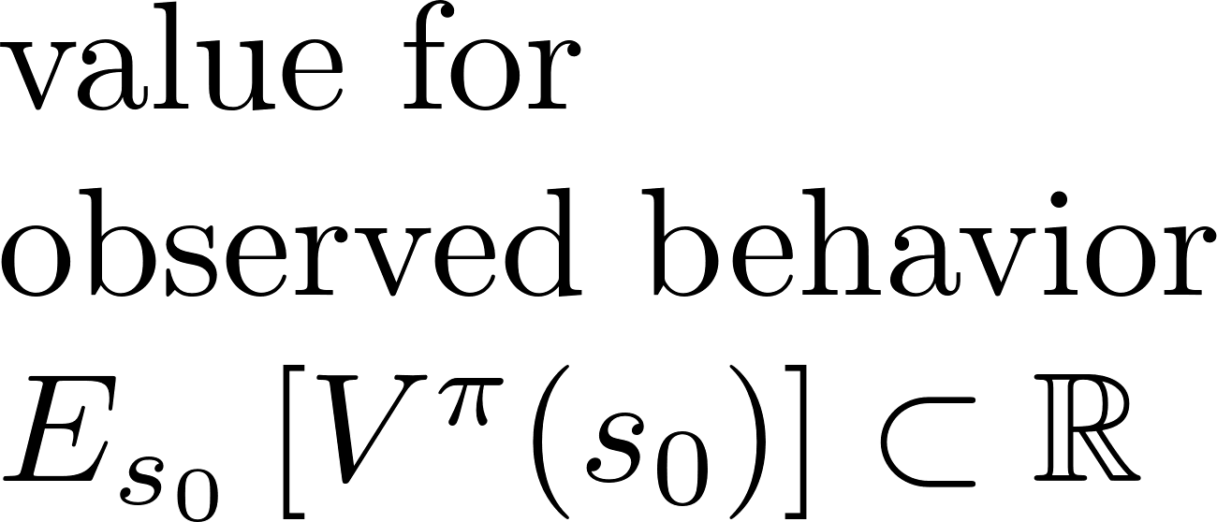
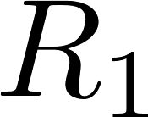
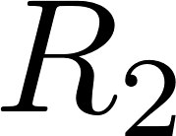
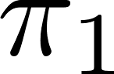
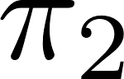
Accurate Inference
Ambiguity in solution: many reward functions (including highly degenerate ones such as a function with all rewards values zero) explain the behavior of demonstrator
space of reward functions
space of MDP policies
?

Slide 22
Accurate Inference
Ambiguity in solution: many reward functions (including highly degenerate ones such as a function with all rewards values zero) explain the behavior of demonstrator
Perturbed Input: learner's sensing of expert's state and action could be imprecise due to noisy sensors, causing an incorrect inference.

Slide 23
Generalizability
Demonstration data often covers a fraction of the complete space.
Learner should compute a reward function that correctly model the preferences of demonstrator for the unobserved space.

Slide 24
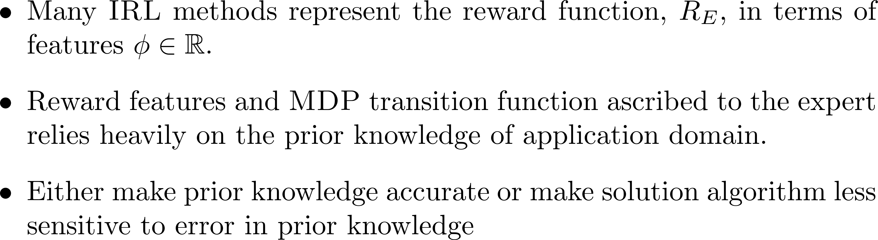
Correctness of Prior Knowledge

Slide 25
Growth in Solution Complexity with Problem Size
Computational complexity is the sum of the time complexity of each iteration and its space complexity
Complexity of solving an MDP is exponential in the number of components of state vector (dimensions). Discretization of continuous state space may lead to an exponential blowup.
As the problem size increases, the expert must demonstrate more trajectories in order to maintain the required extent of training.

Slide 26
Direct Learning of Reward or Policy Matching
Learning Approaches:
approximate parametric reward function by tuning it using input data
learning a parametric policy by matching its actions (action values) with demonstration, using reward function only as means
First offers better generalization to the task at hand, it may lead to policies that do not fully reproduce the observed trajectories
Second approach results in precise imitation but it is limited in its generalizability

Slide 27
Part 2 -- Foundational Methods
Maximum Margin Optimization
Entropy Optimization
Bayesian Update
Regression and Classification

Slide 28
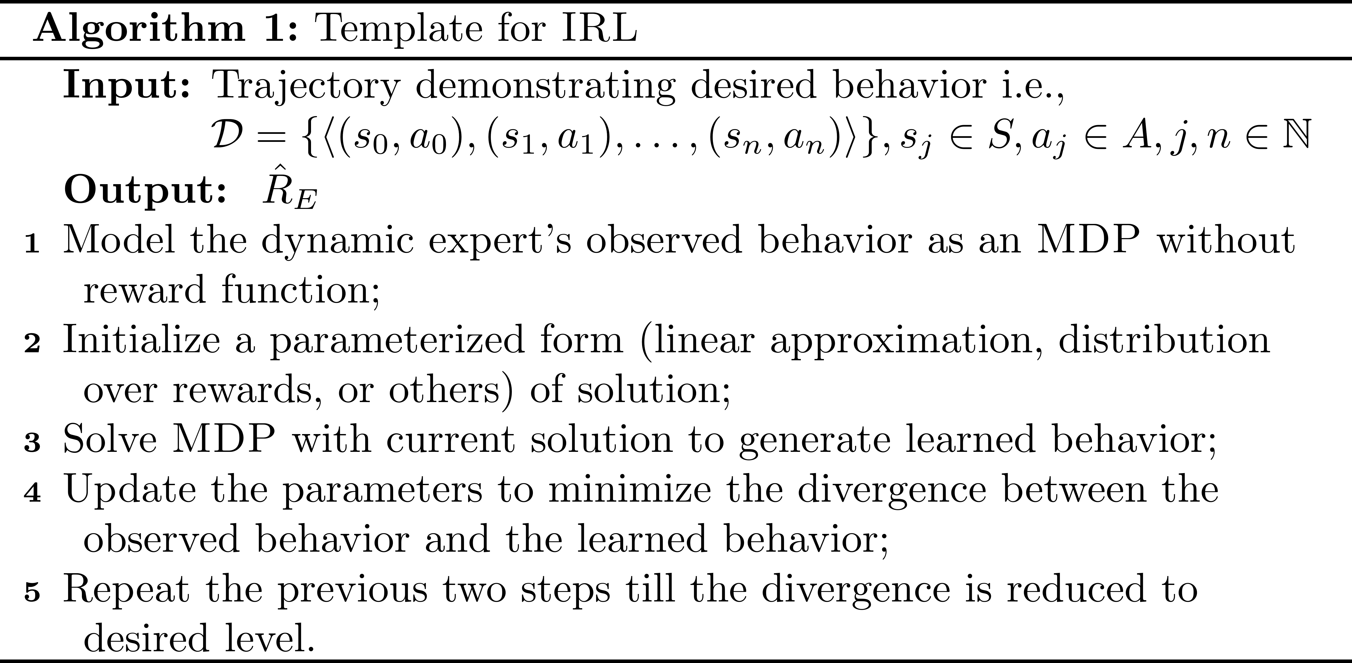
Template

Slide 29
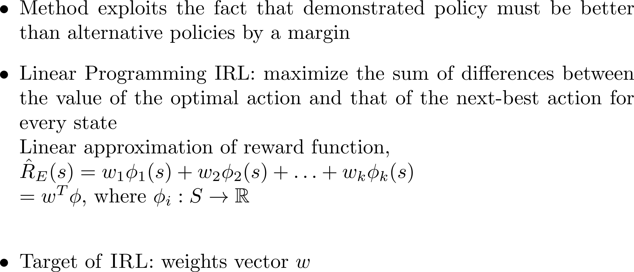
Maximum Margin Optimization

Slide 30
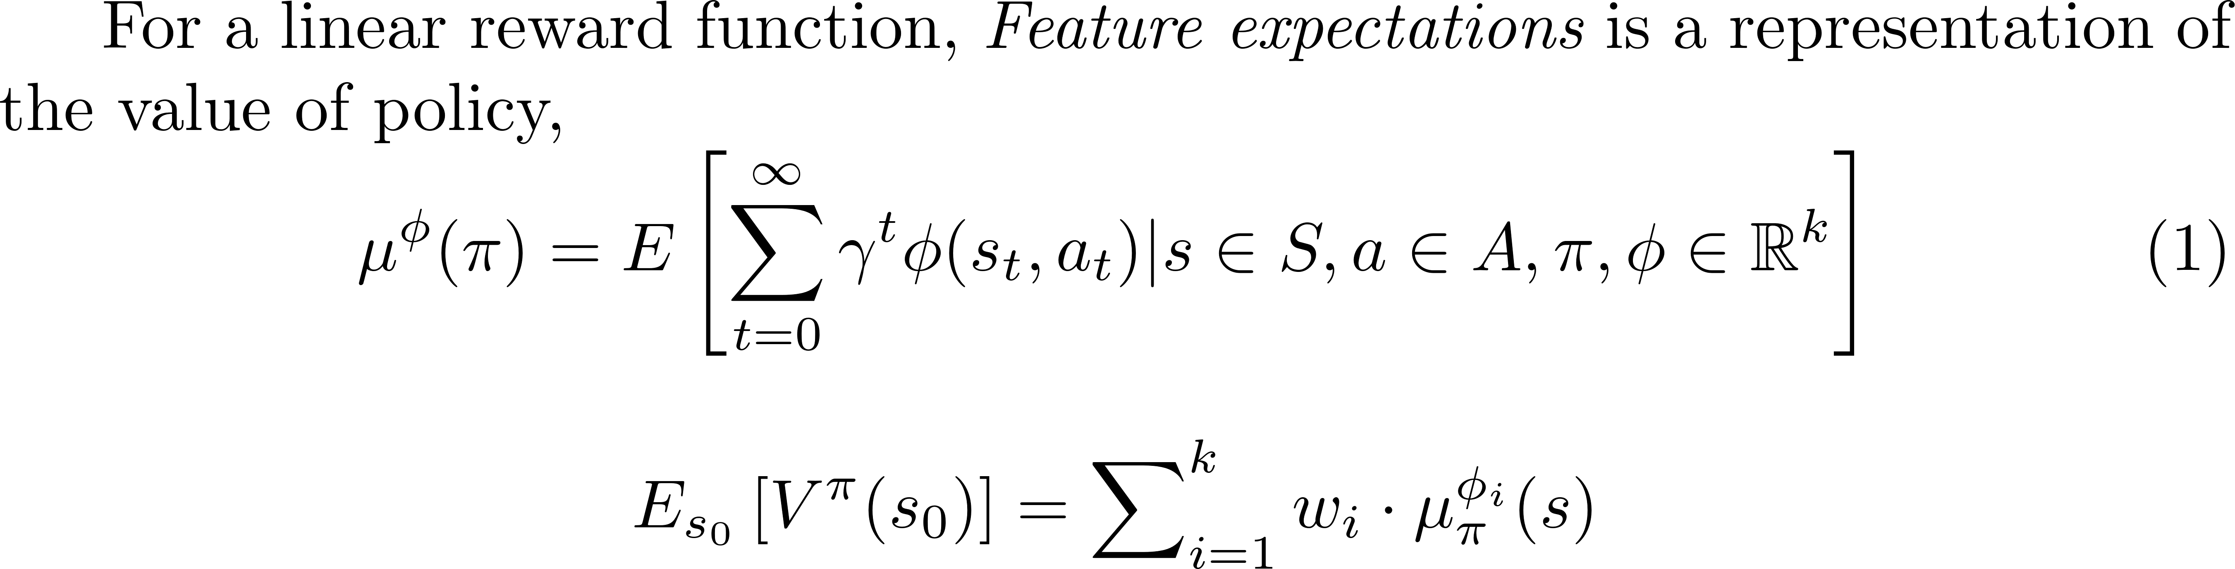
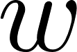
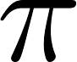

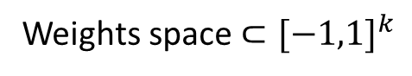
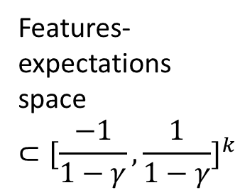
Maximum Margin Optimization
Weights space $⊂{[−1,1]}^{k}$
Policy space
Features-expectations space
$$⊂{[\frac{−1}{1−γ},\frac{1}{1−γ}]}^{k}$$

Slide 31
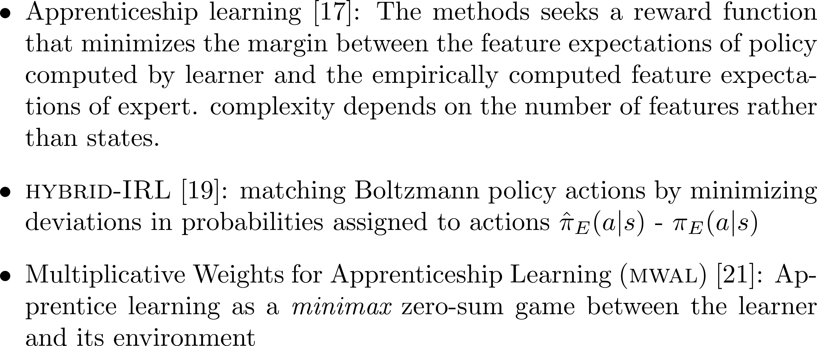
Maximum Margin Optimization

Slide 32
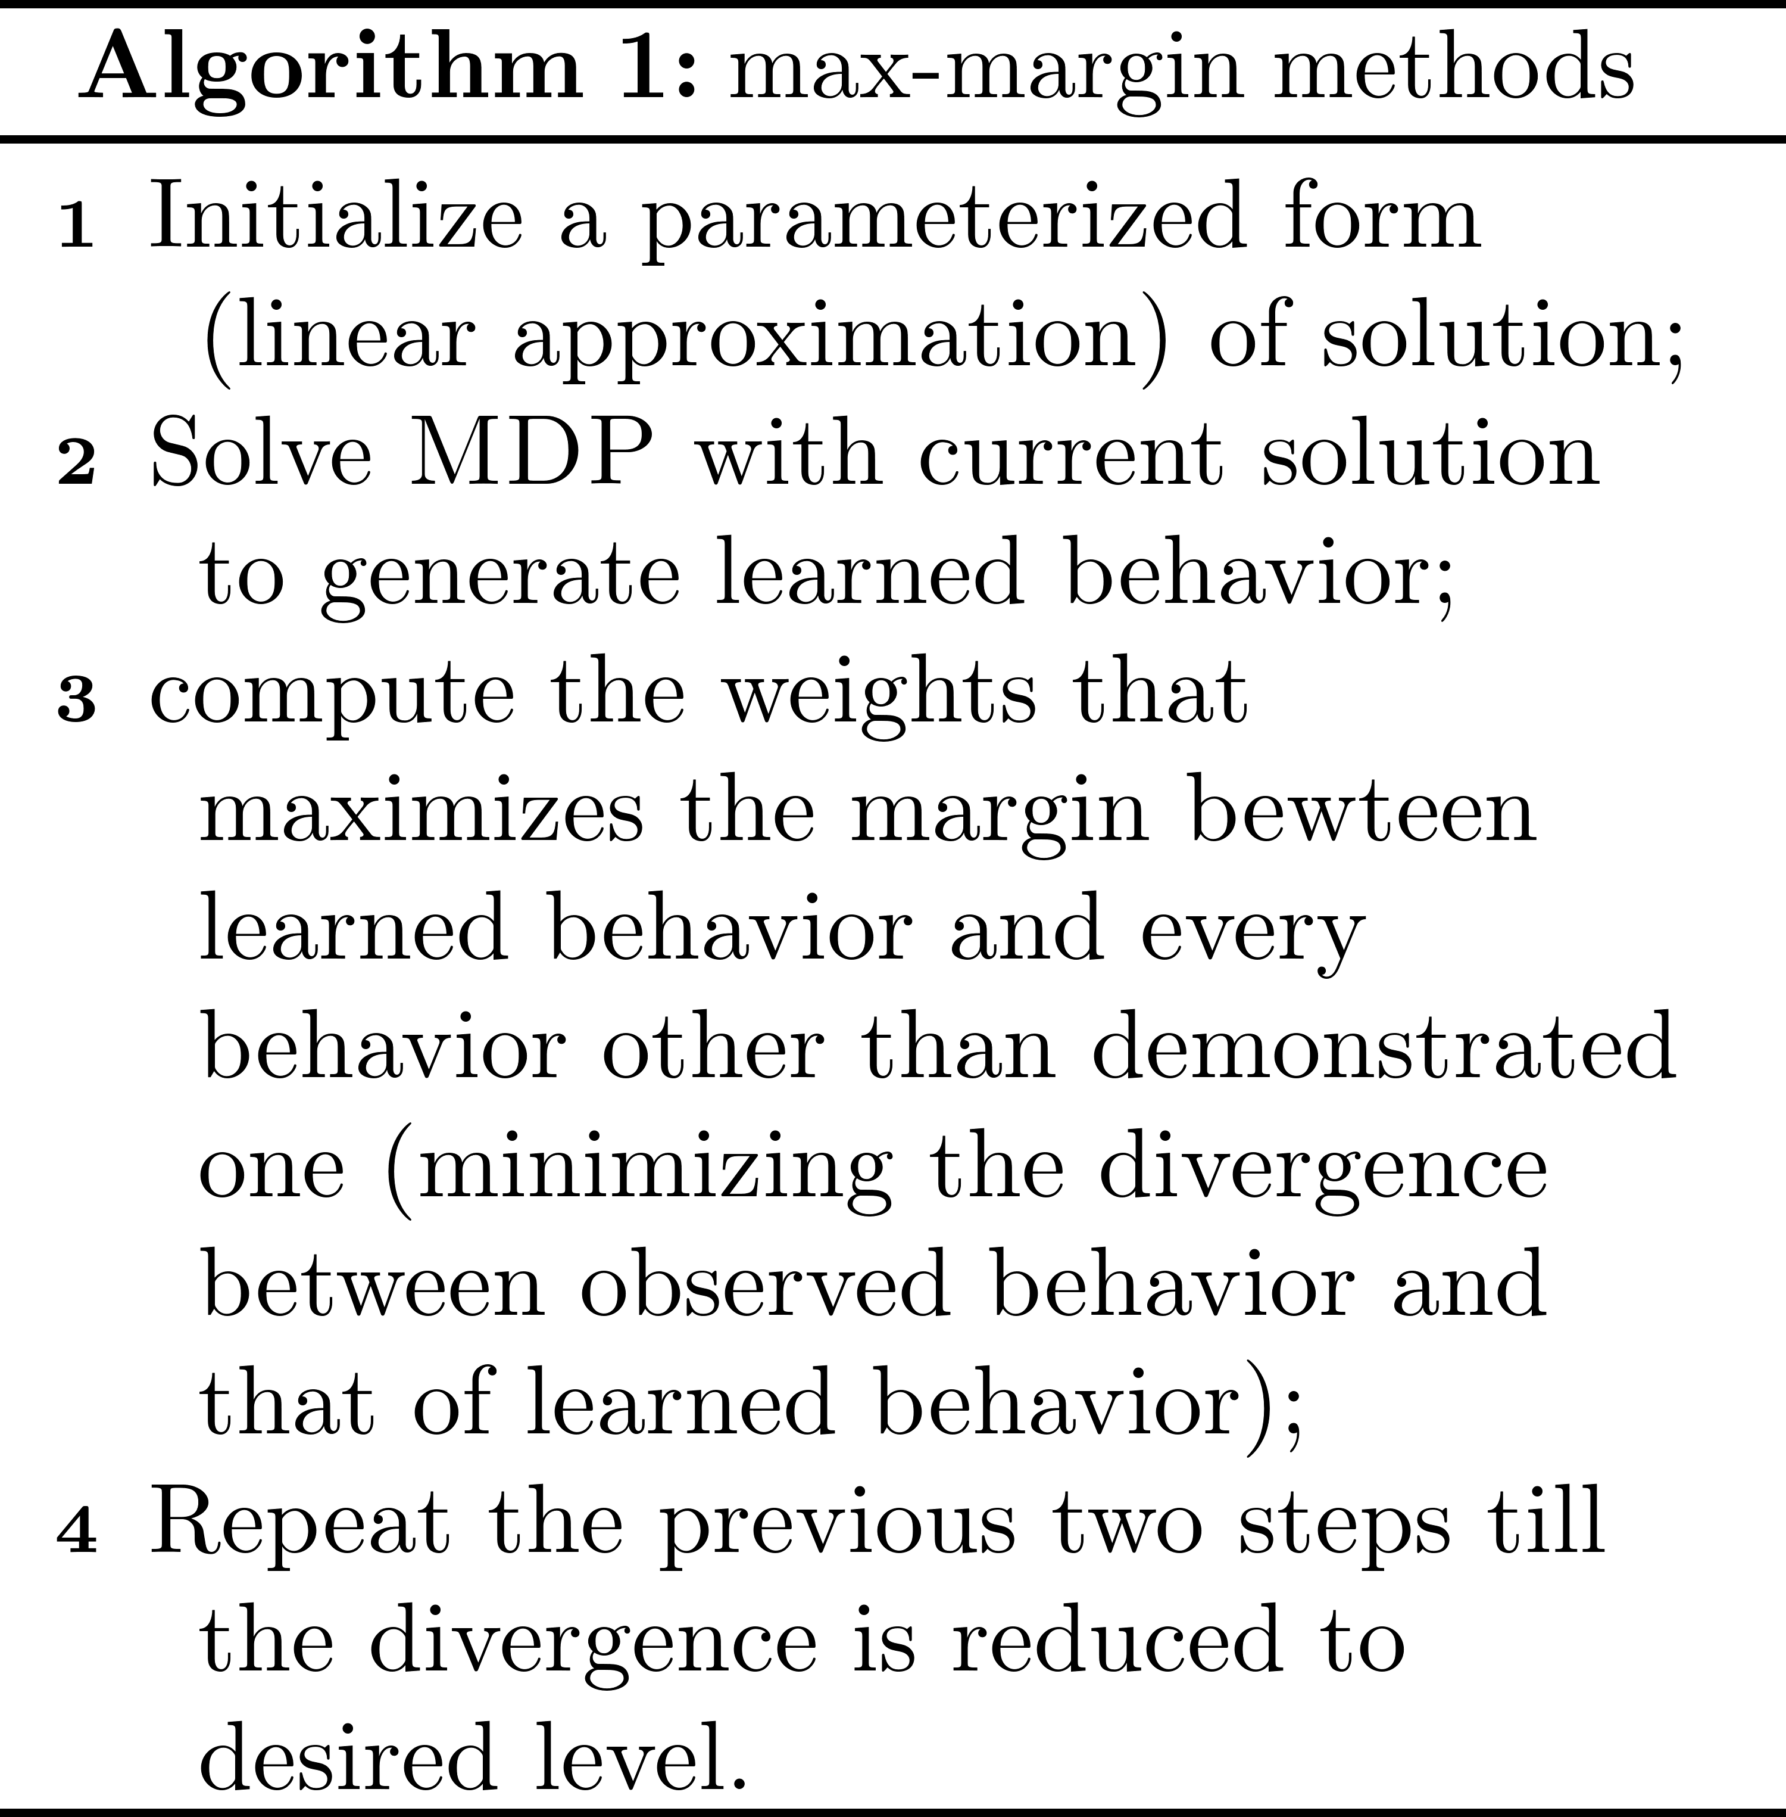
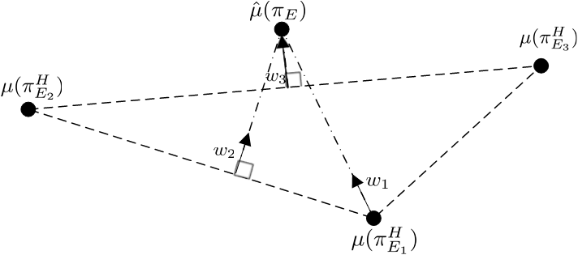
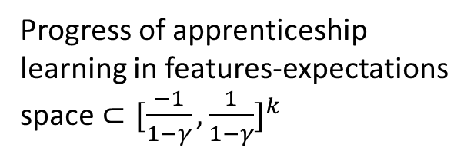
Maximum Margin Optimization
Progress of apprenticeship
learning in features-expectations
space $⊂{[\frac{−1}{1−γ},\frac{1}{1−γ}]}^{k}$

Slide 33
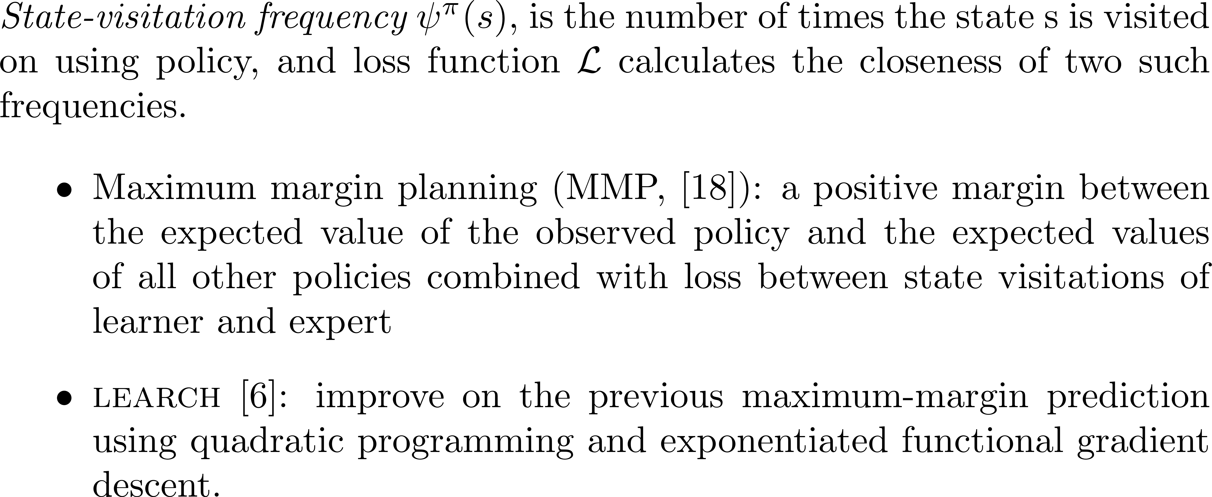
Maximum Margin Optimization

Slide 34
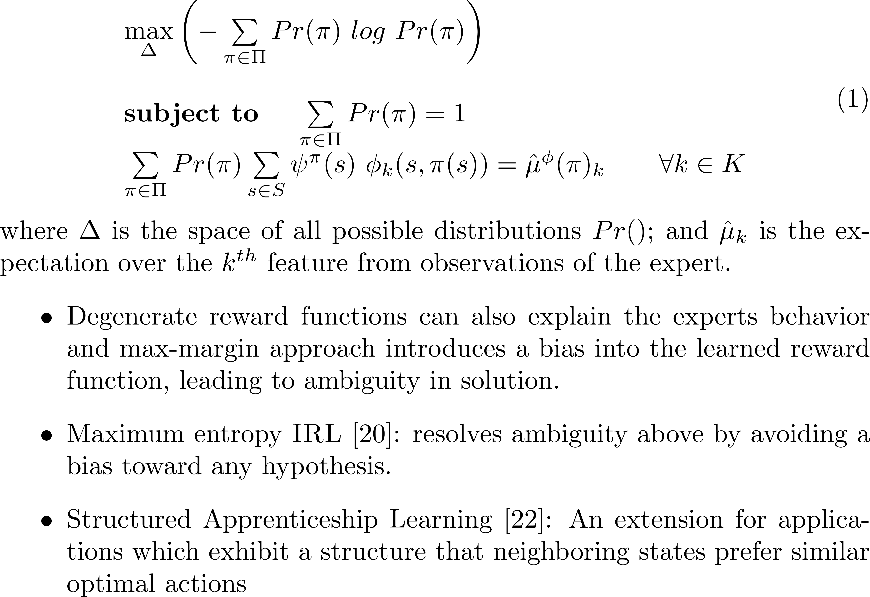
Entropy Optimization

Slide 35
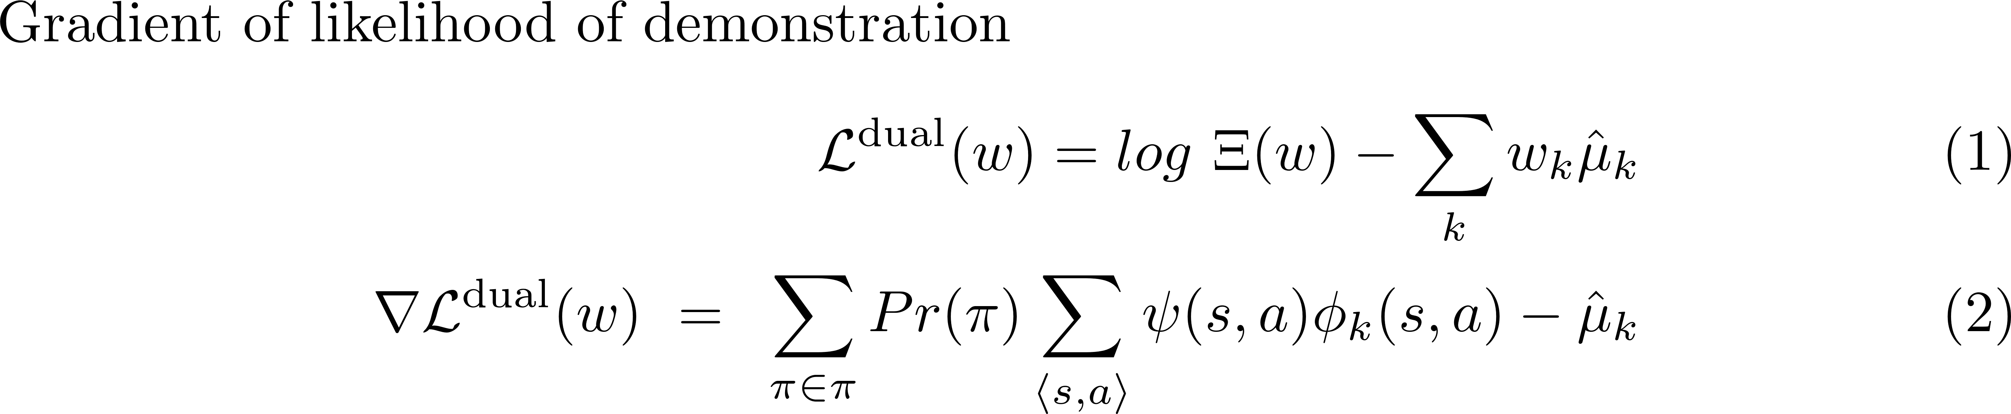
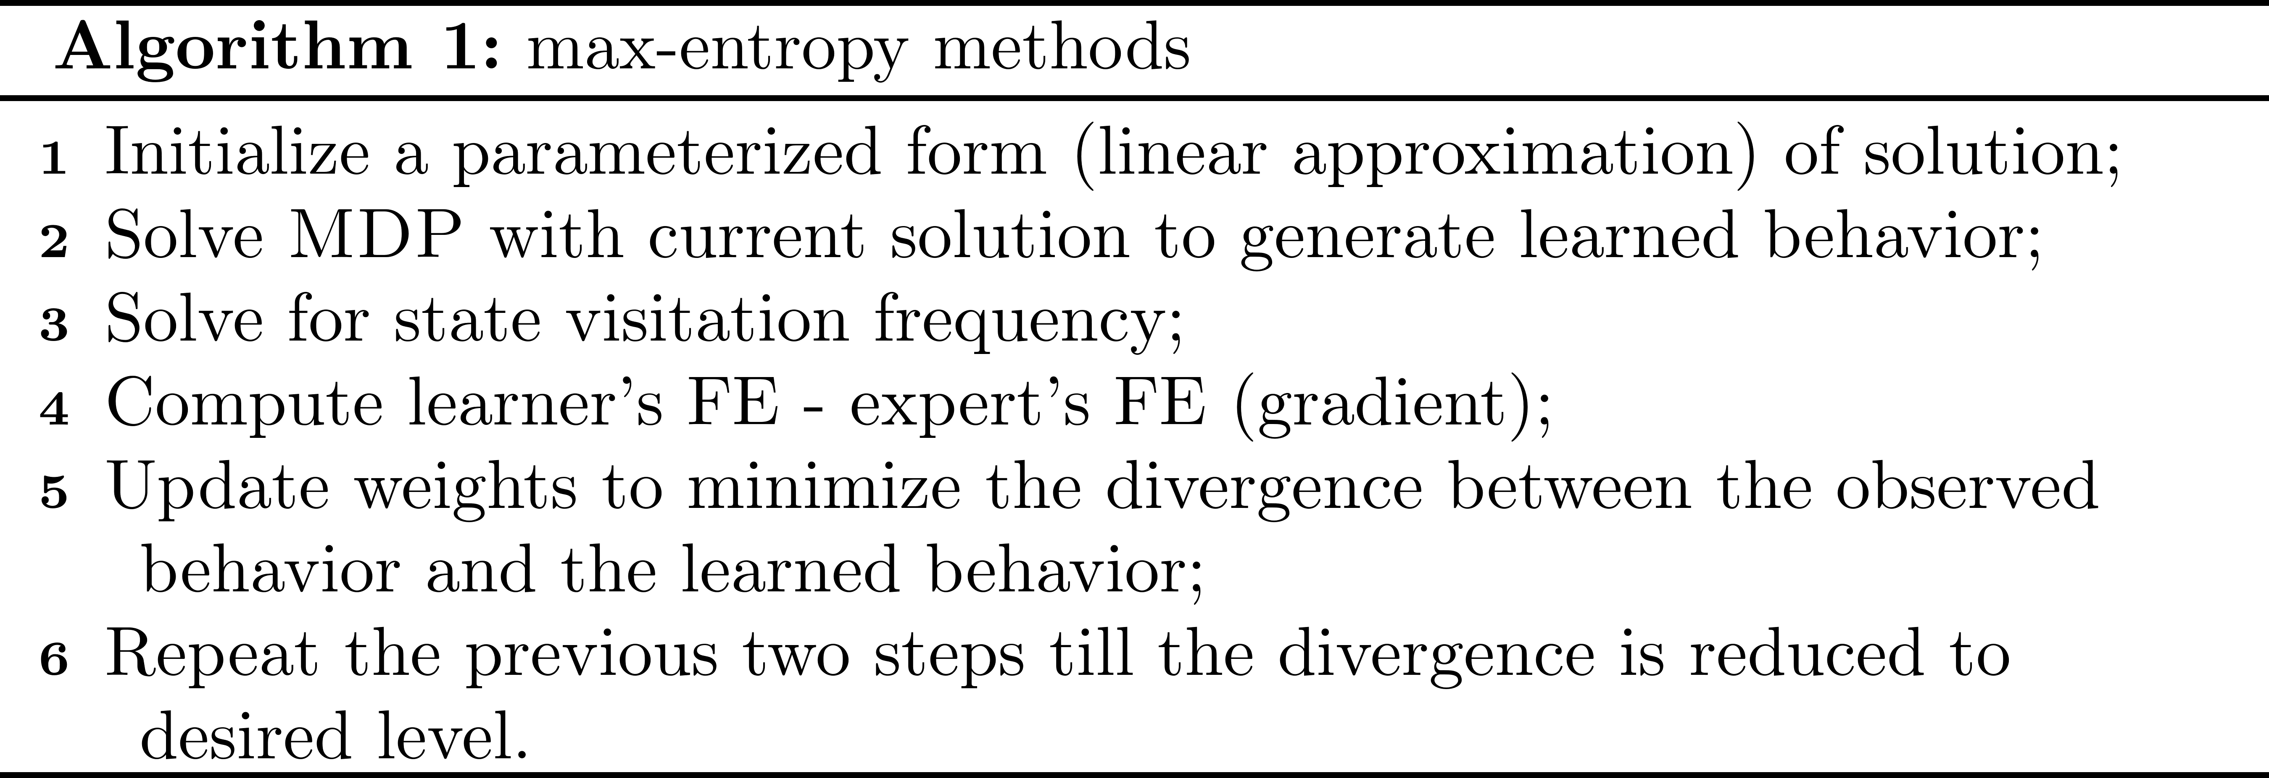
Entropy Optimization

Slide 36
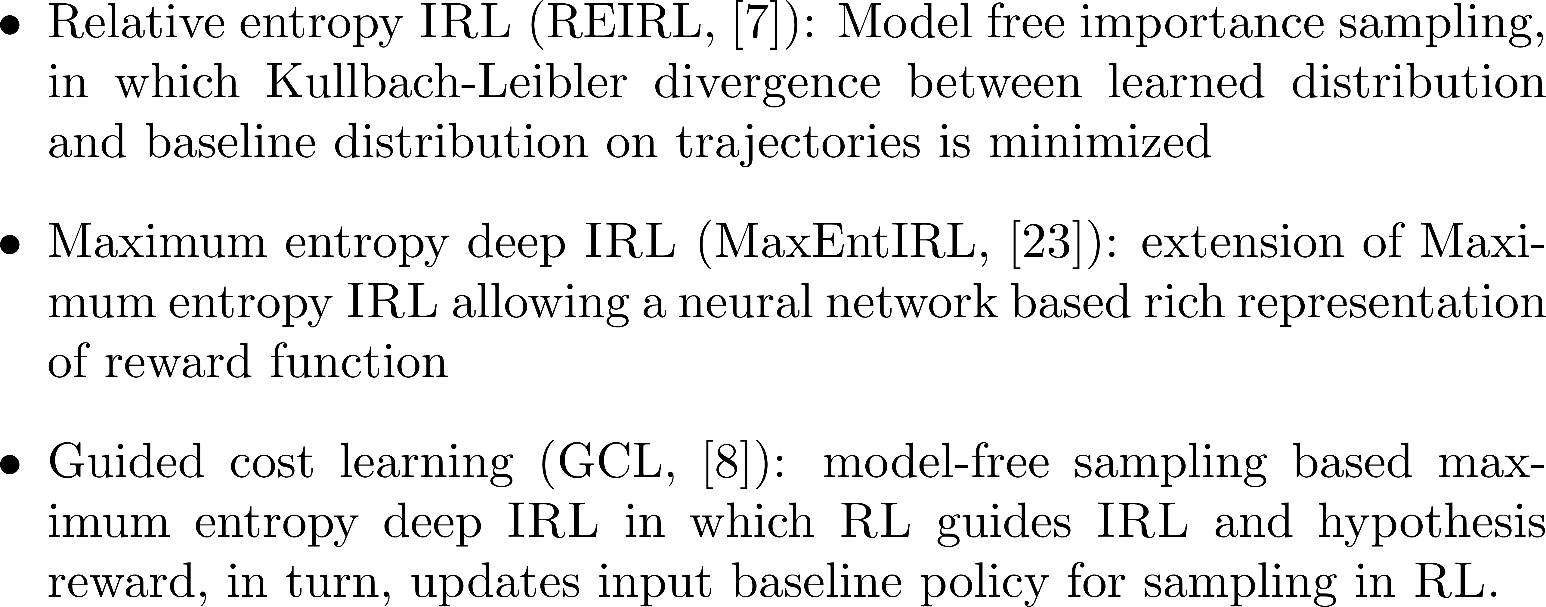
Entropy Optimization

Slide 37
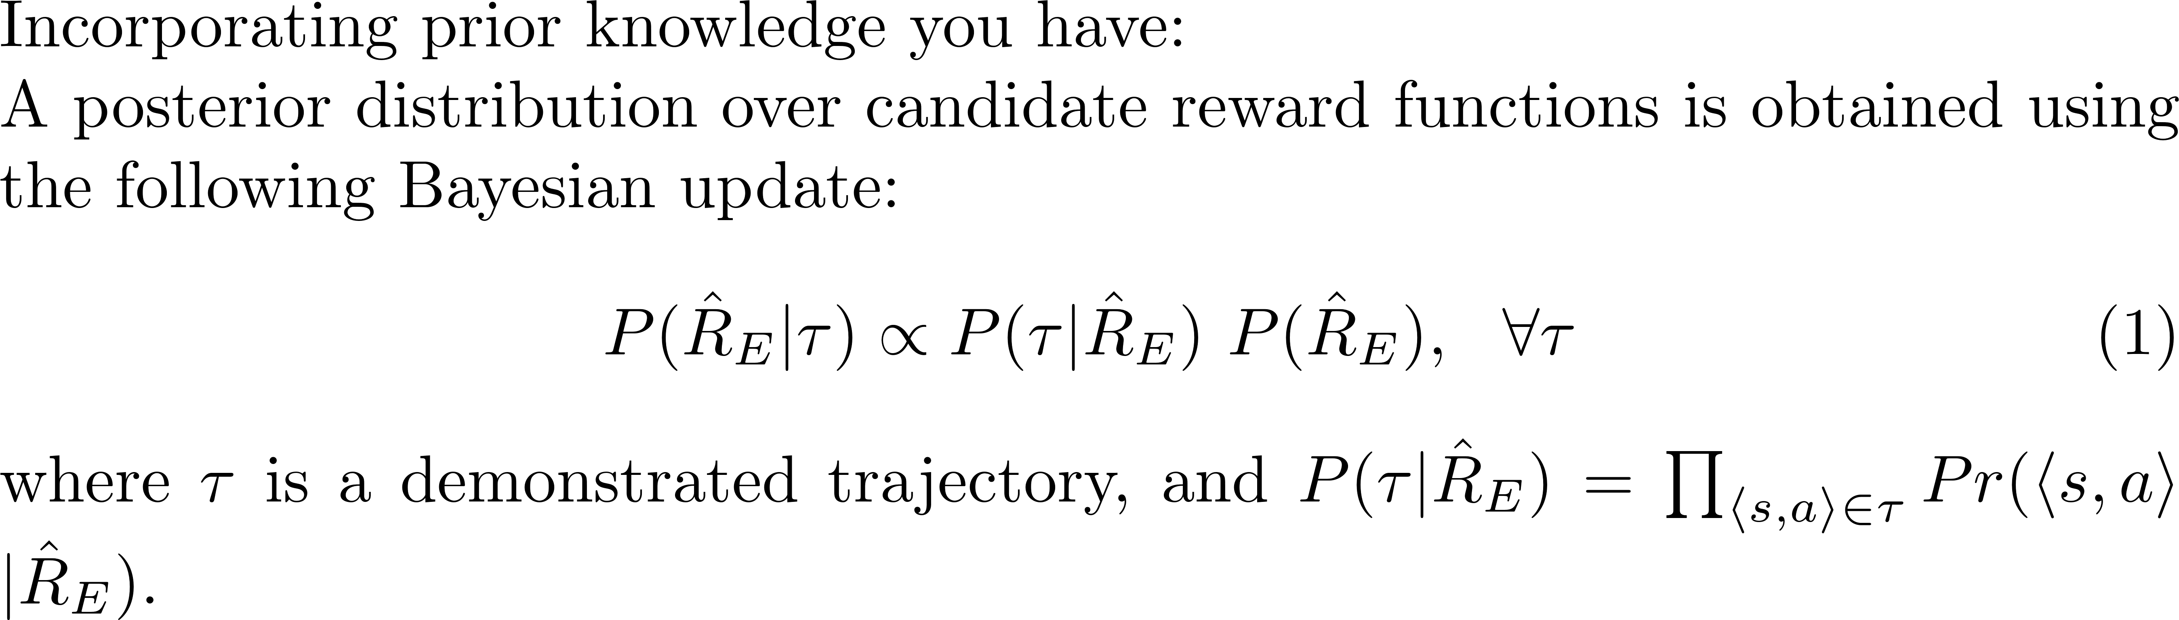
Bayesian Update

Slide 38
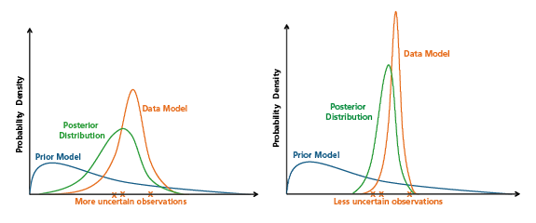
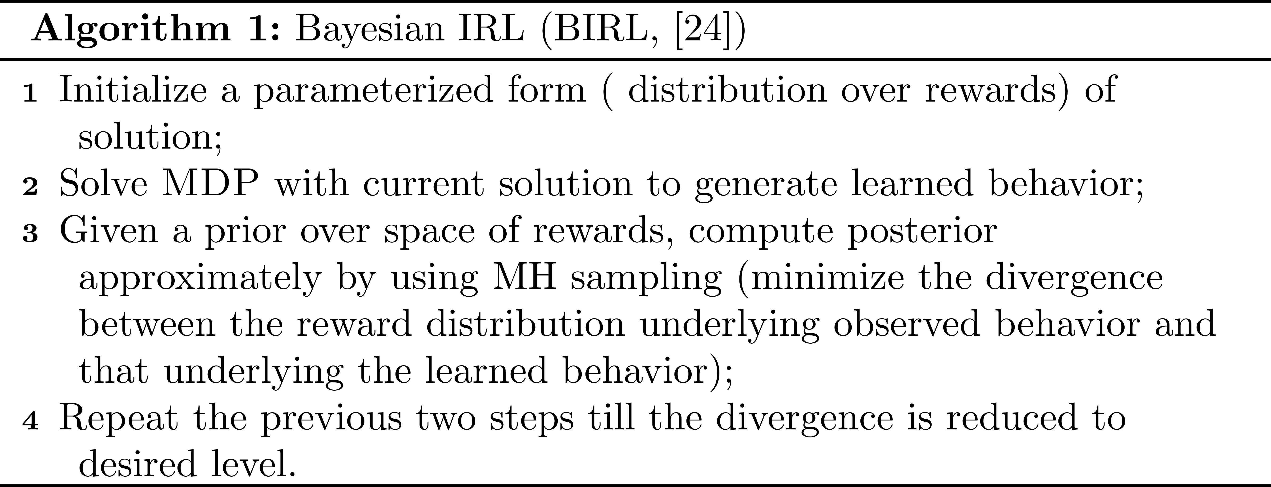
Bayesian Update

Slide 39
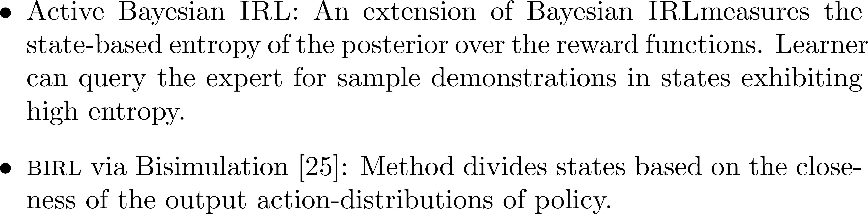
Bayesian Update

Slide 40
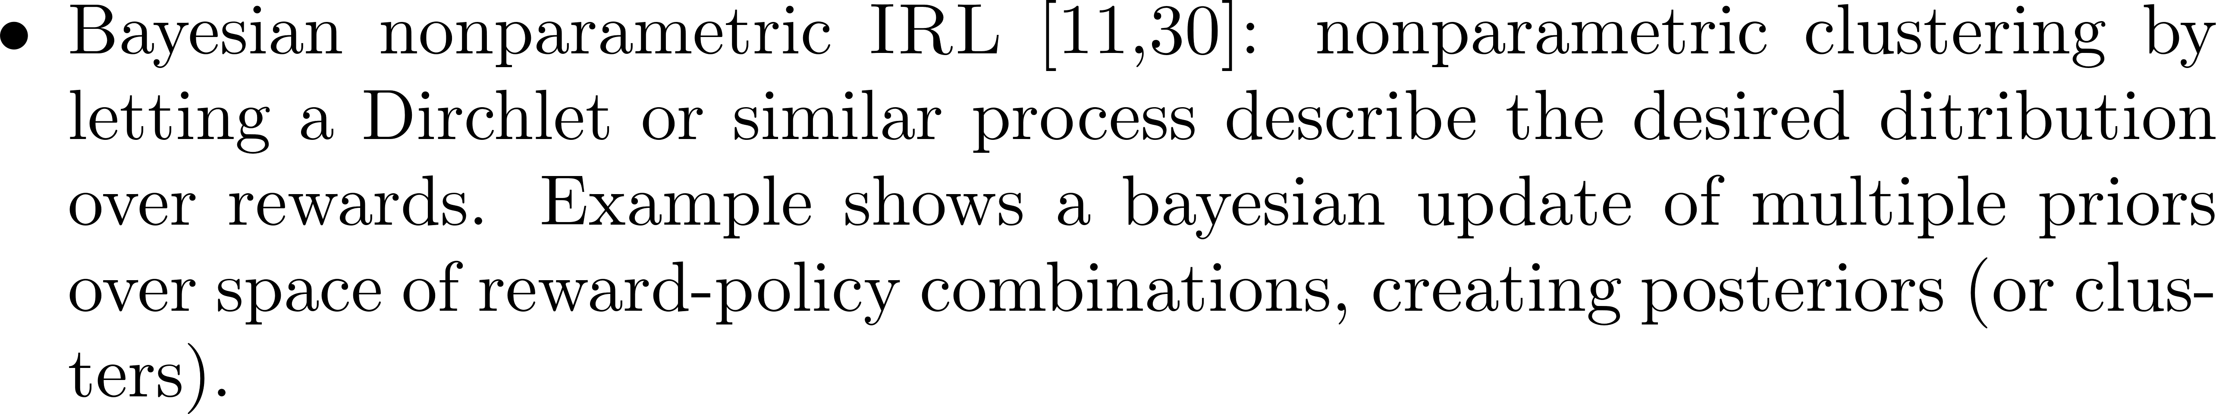
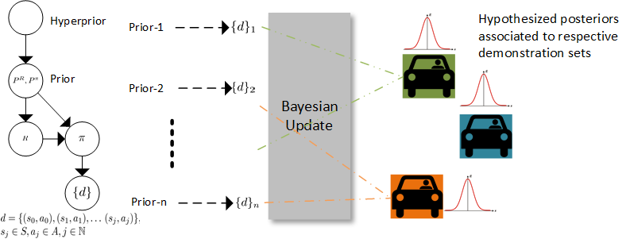
Bayesian Update
Hierarchichal
Network
demonstrations

Slide 41
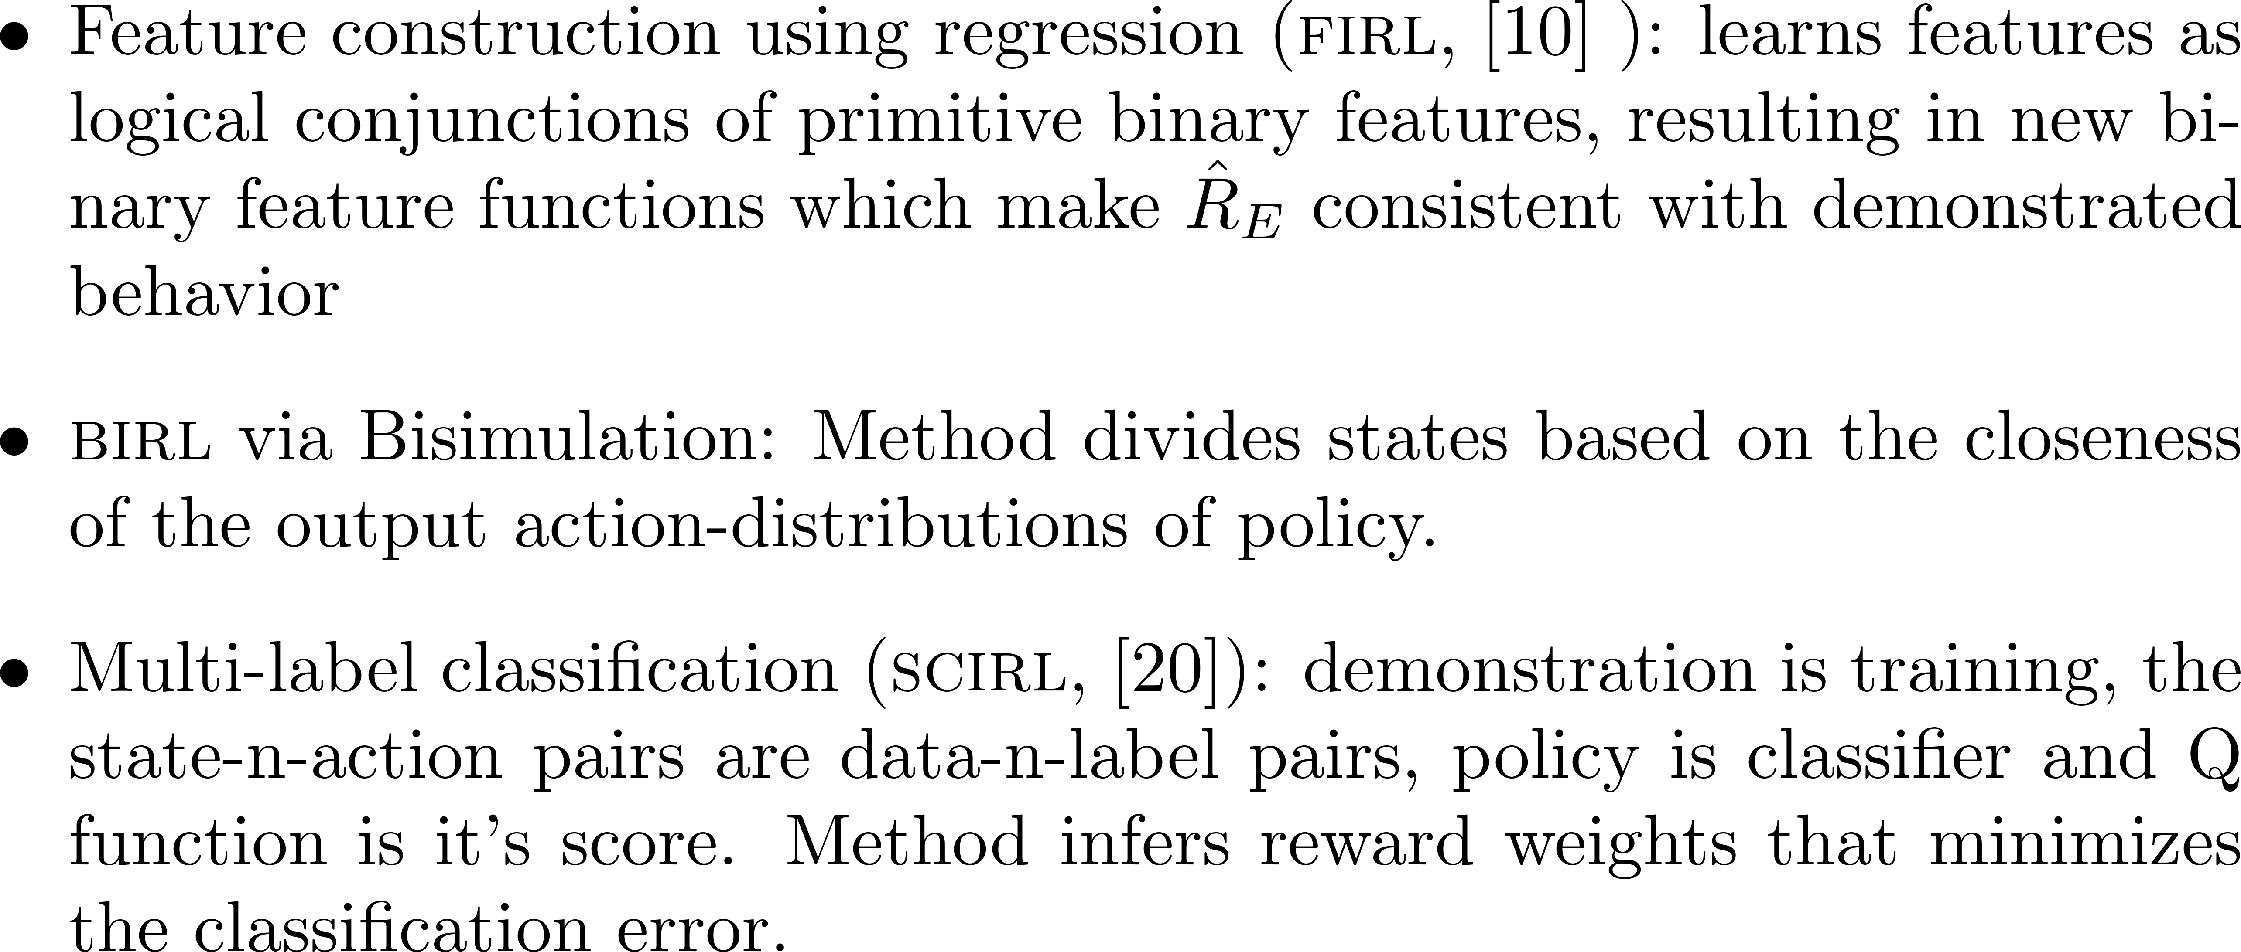
Regression and Classification

Slide 42
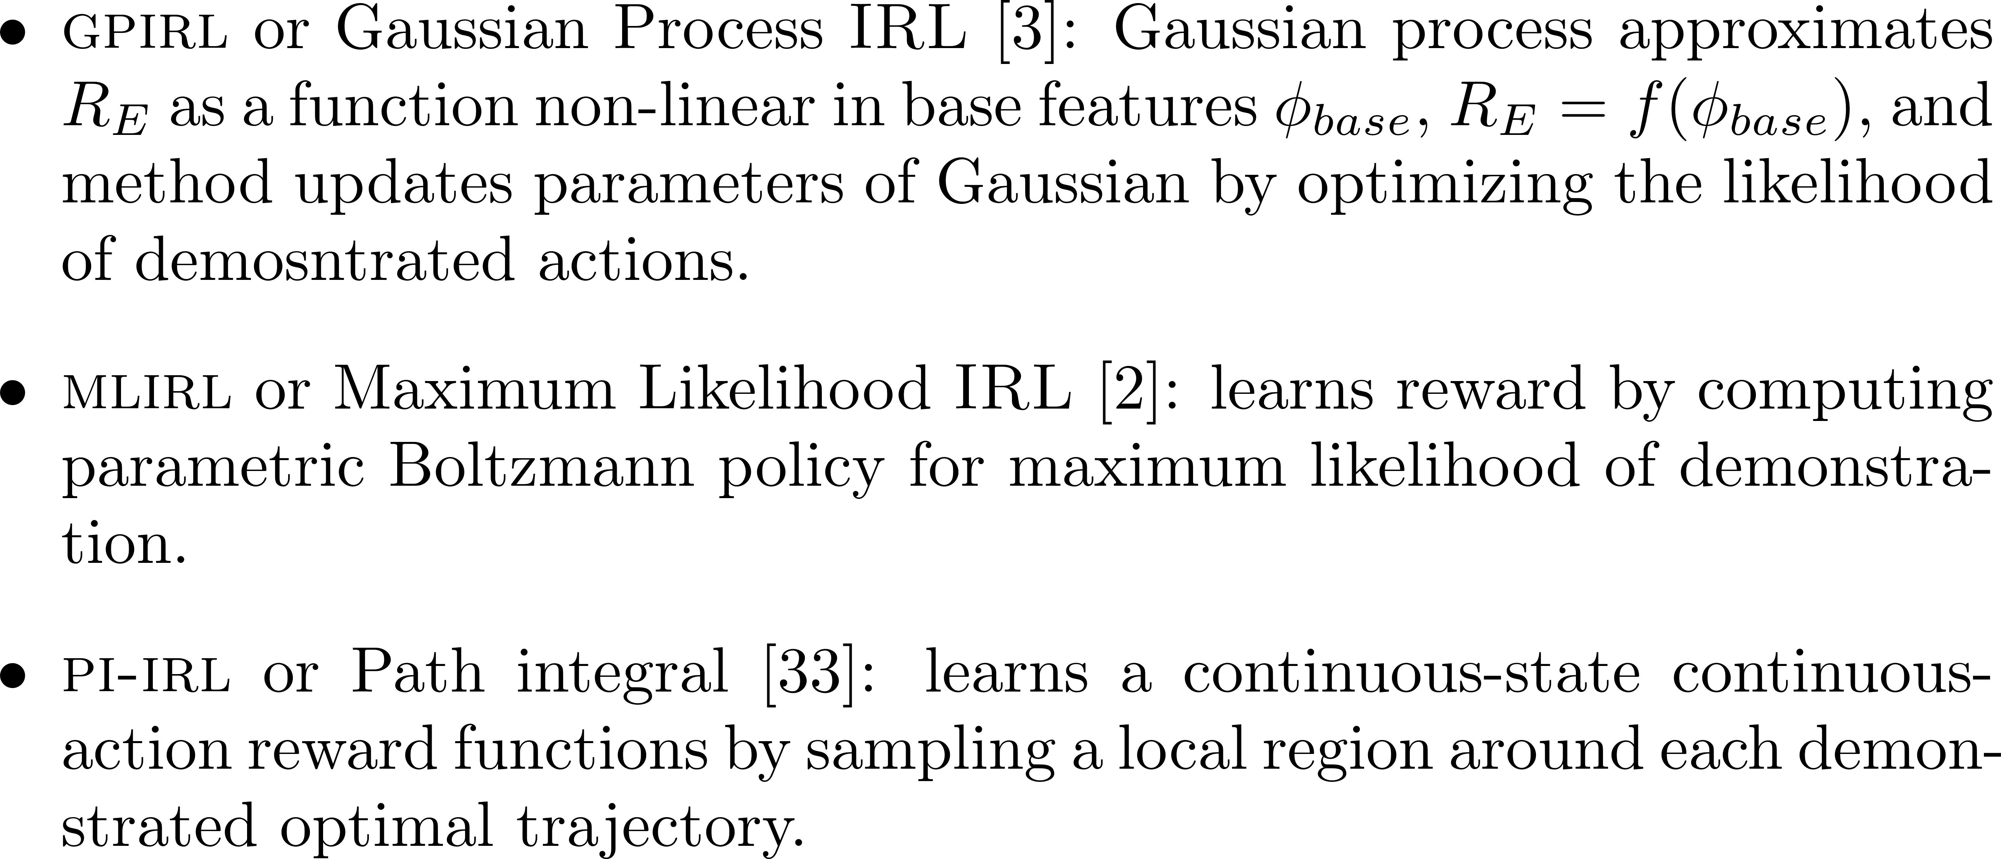
Other Methods

Slide 43
Part 3 -- Mitigating Challenges
Improvement in Accuracy of IRL
Analysis and Improvement of Complexity
Continuous and High-Dimensional State Spaces
High Dimensionality
Generalizability

Slide 44
Accuracy of IRL: Learning from Faulty Input
Perturbations:
Max Entropy, Bayesian and some other probabilistic methods inherently account for the perturbation in their framework that explain suboptimal behavior as noise
MMP and similar methods introduce slack variables in their optimization objective. LEARCH relaxed constraints in optimization problem (follow the lowest cost paths that are close to the examples rather than imitating examples)
Ziebart et al [1] showed that with an imperfect demonstration, MAXENTIRL learns a reward function corresponding to behavior with higher return than reward function learned by MMP.

Slide 45
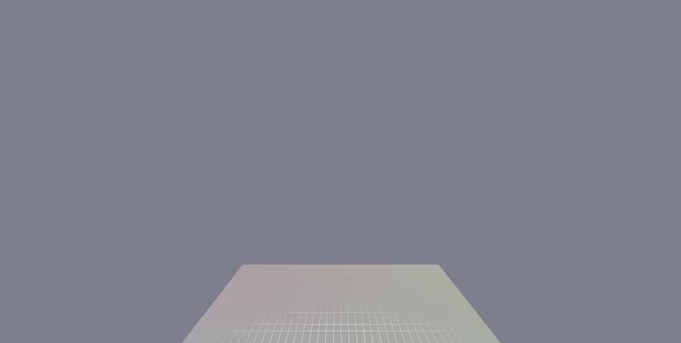
Accuracy of IRL: Learning from Faulty Input
Coates et al. [14] introduced de-noising the demonstration before inferring reward
Airshow Recorded demonstrations

Slide 46

Accuracy of IRL: Learning from Faulty Input
Coates et al. introduced de-noising the demonstration before inferring reward
Airshow Recorded demonstrations
Aligned demonstrations (white trajectory is least perturbed)

Slide 47
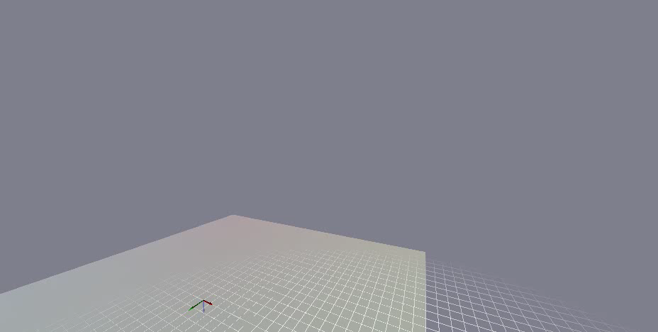
Accuracy of IRL: Learning from Faulty Input
Coates et al. introduced de-noising the demonstration before inferring reward
Airshow Aligned demonstrations
Flight performance (black trajectory after learning)

Slide 48
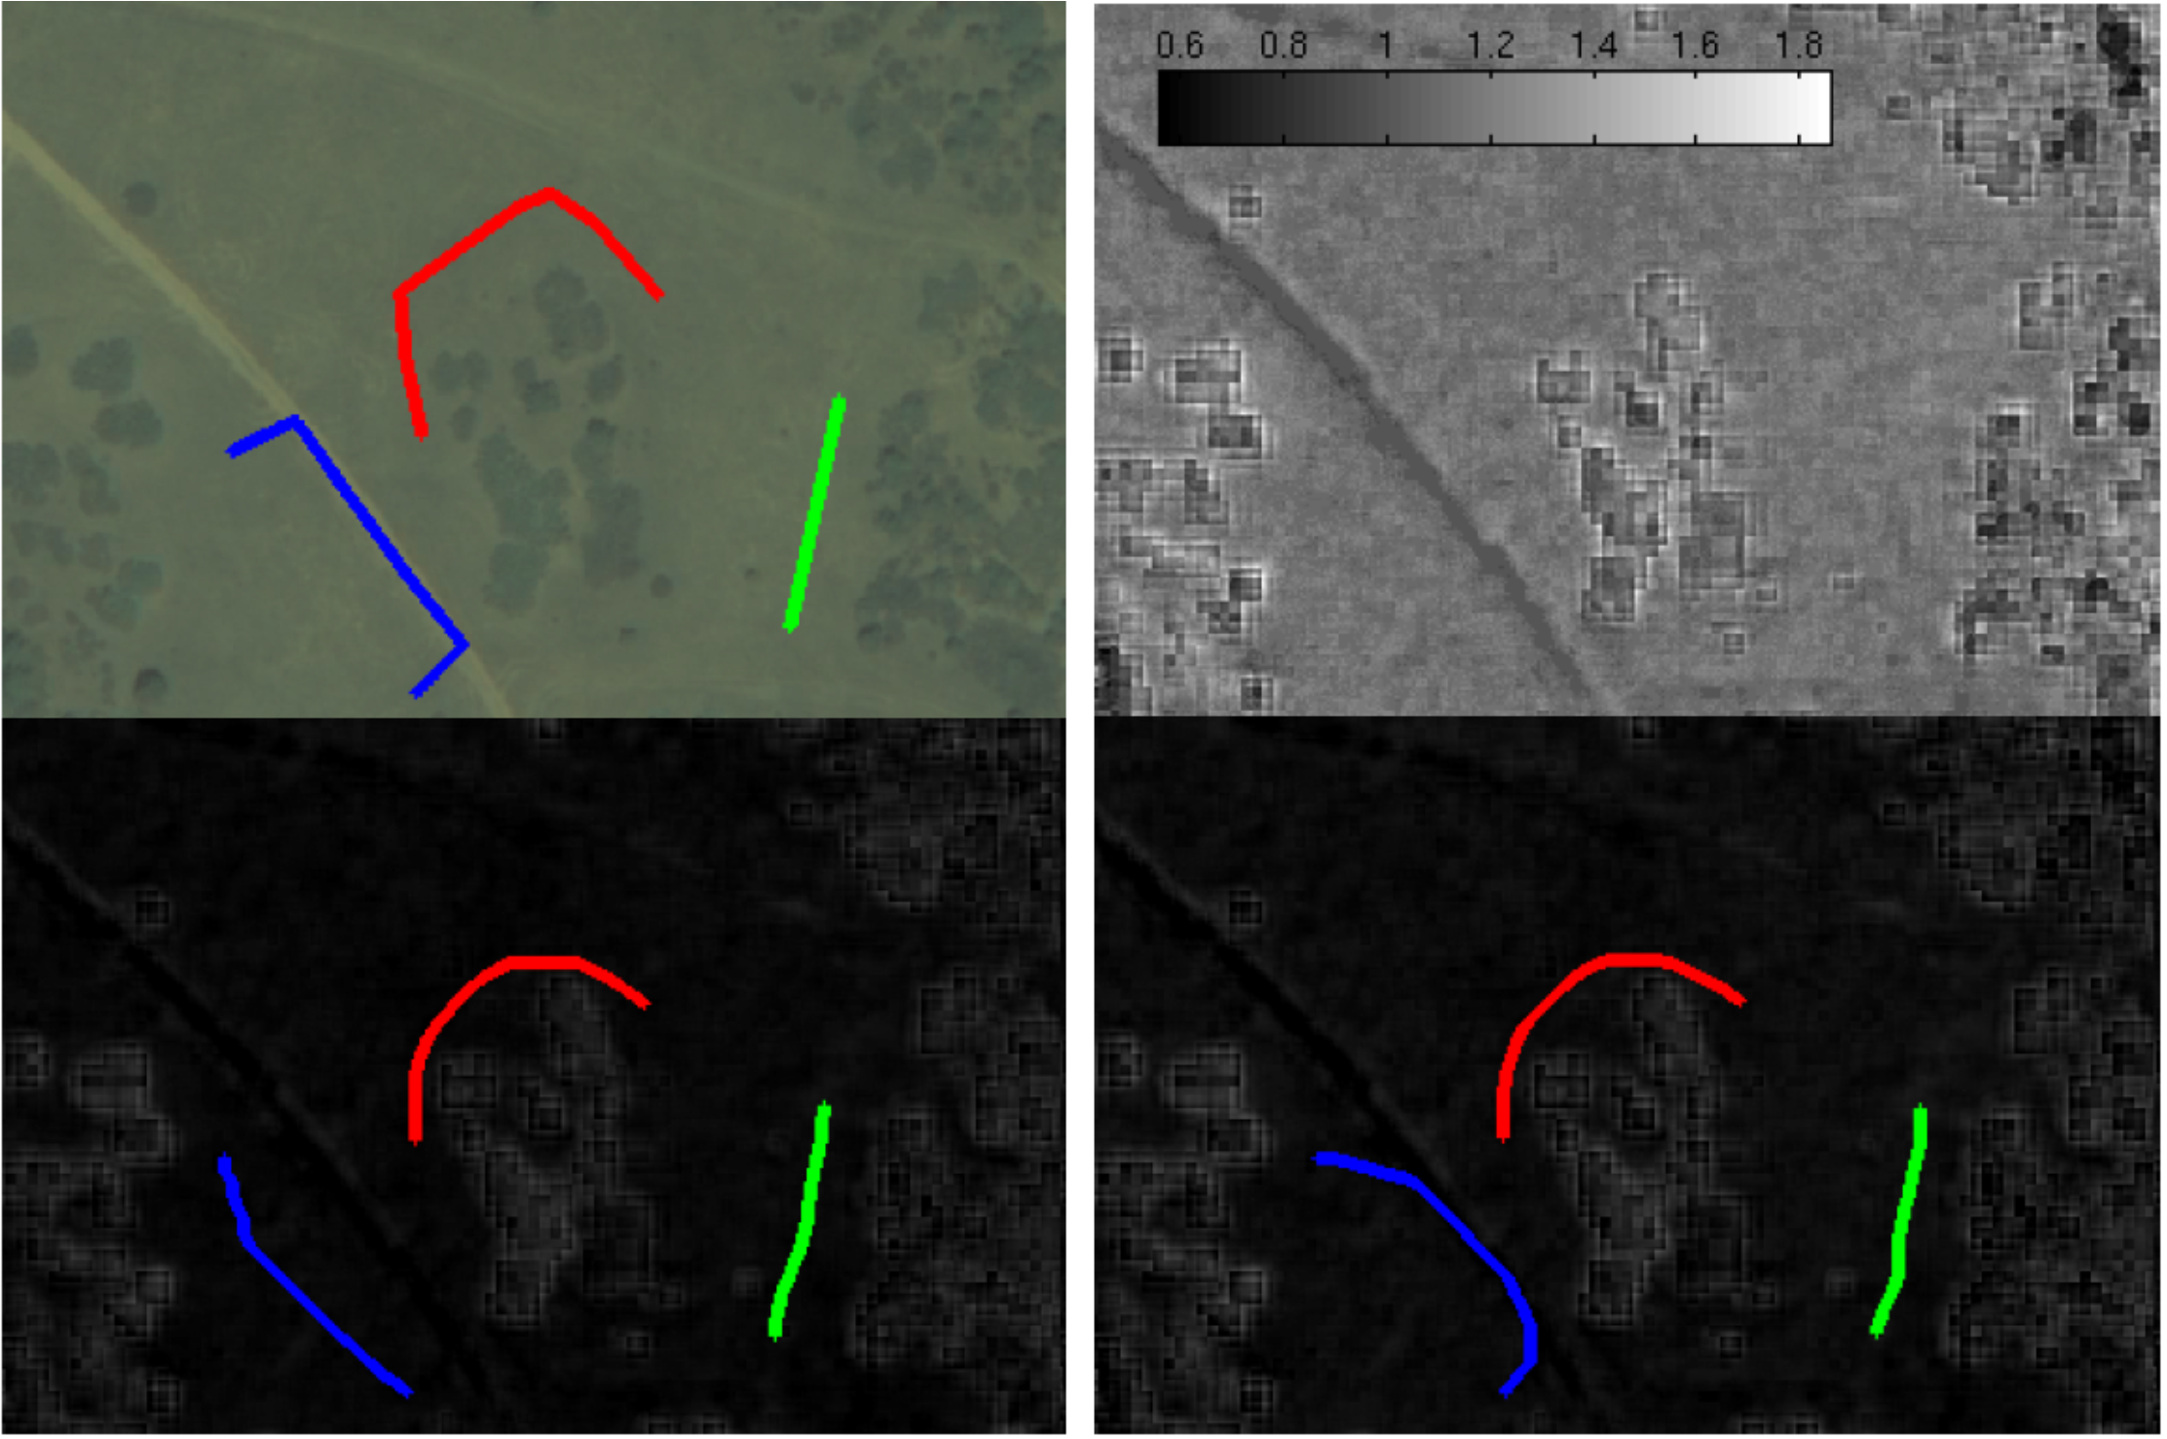
Accuracy of IRL: Learning from Faulty Input
Over Training:
Unusually long demonstration trajectories may increase state visitations in undesired part of space. Silver et al. [6] solved it using functional gradient normalized by the state visitation counts.
Undesired bending
in demonstration
Suboptimal imitations
due to over training
Solution with
normalized functional grad

Slide 49
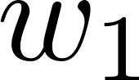
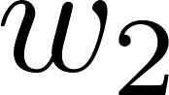
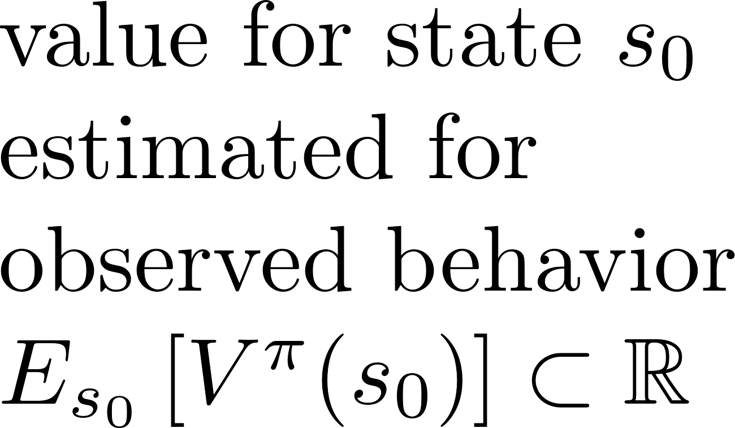
Accuracy of IRL: Ambiguity in Hypotheses
space of parameters defining reward
space of MDP policies
?

Slide 50
Accuracy of IRL: Ambiguity in Hypotheses
1- Heuristics:
LP favored solutions maximizing the difference in the values of expert’s actions (and values incurred after those actions) than other possible actions in same state.
Max-margin & Projection IRL avoid degenerate solutions by favoring the value of learned policy’ close to expert’s
MMP introduced state-visitation dependent definition of loss function to avoid degenerate null reward functions
Hybrid-IRL solves the degeneracy by preferring actions same as expert’s

Slide 51
Accuracy of IRL: Ambiguity in Hypotheses
1- Heuristics:
…
2- Optimization Constraints and Prior Domain Knowledge:
MaxEnt-IRL infers a unique reward function by using a probabilistic framework avoiding any constraint other than making the policy values same as expert’s.
Likelihood objectives in Bayesian techniques and GPIRL limit the probability mass of its output to that specific subset of reward functions or that mean of posterior which supports the demonstrated behavior.

Slide 52
Accuracy of IRL: Lowering Sensitivity to Features
Hybrid-IRL that uses policy matching and all maximum entropy based methods tune distributions over the policies or trajectories
The size of the feature space influences the error in estimated value of expert’s policy (his feature expectations). Ziebart et al. [20] showed an improvement in the bound on the error from O(k) to O(log k)

Slide 53
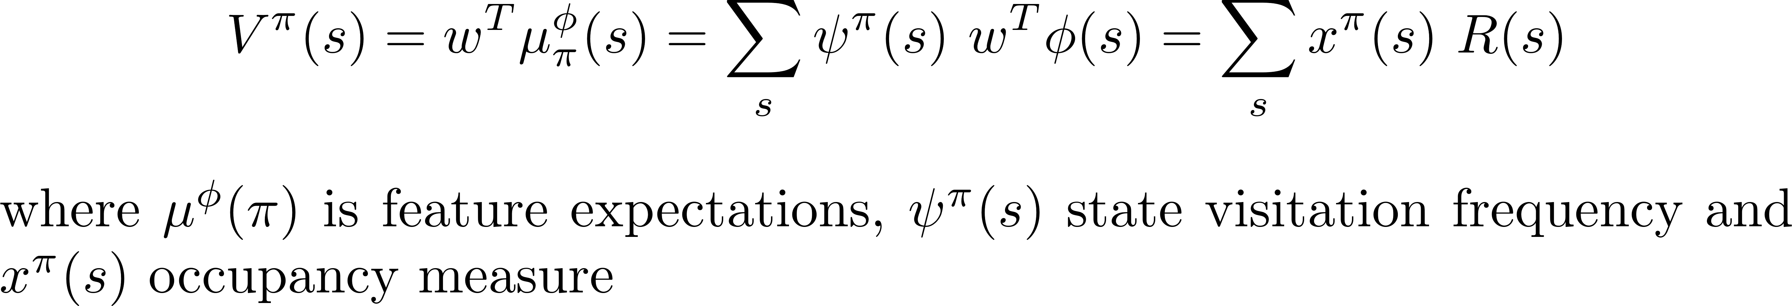
Accuracy of IRL: Theoretically Guaranteed Accuracy
For a method based on feature expectations or occupancy measure, there exists a probabilistic upper bound on the bias in estimated value of expert’s policy, and thereby a bound on learning error.

Slide 54
Accuracy of IRL: Theoretically Guaranteed Accuracy
Unlike game-theoretic approaches, maximum entropy distribution over space of policies (or trajectories) is know to minimize the worst-case expected loss w.r.t. distribution representing expert’s behavior. IT learns a behavior which is neither much better nor much worse than expert’s
Unlike probabilistic methods, classification based approaches CSI [27] and SCIRL admit a theoretical guarantee for optimality of behavior corresponding to learned reward function

Slide 55
Accuracy of IRL
Improvement in learning accuracy in MLIRL [2], LEARCH, and GPIRL
Comparison of the values of
policies learned by methods
in Gridworld domain [2]

Slide 56


Analysis and Improvement of Complexity
Active Bayesian IRL seeks to ascertain the most informative states where a demonstration is needed, and therefore exhibit relatively reduced sample complexity.
Bayesian IRL with Bisimulation [25] exploited an equivalence among the states to reduce the sample complexity

Slide 57
Analysis and Improvement of Complexity
Bayesian IRL converges in polynomial time.
MWAL requires O(ln k) (k is number of features) iterations for convergence, which is lower than O (k * ln k) for the Projection method
FIRL achieves more accuracy than MMP and Projection methods at the cost of speed, due to the computationally expensive step of regression for constructing features

Slide 58
Continuous State Spaces
Path integral based approaches aims for local optimality of demonstrations (avoid complete solution of MDP); this approximation scales well to high-dimensional continuous spaces and large demonstration data
Authors like Melo et al. [25] suggest the use of MDP metric for continuous state spaces to exploit their good theoretical properties for avoiding the cost of supervised learning or optimization-based learning in continuous spaces.

Slide 59
High Dimens ional and Large Spaces
For an exponential likelihood based method (MaxEnt, MLIRL) , computational complexity scales exponentially with the dimensionality of state.
Approximating Likelihood: replacing the goal of global optimality of the input policy with local optimality, use of importance sampling by REIRL, the down-scaling the state space using low-dimensional features

Slide 60
High Dimens ional and Large Spaces
For an exponential likelihood (MaxEnt) based method, computational complexity scales exponentially with the dimensionality of state.
Approximating Likelihood
Task Decomposition: exploitation of the hierarchical structure of a physical system (e.g. Kolter et al. [4,5] - quadruped locomotion)
Series of
footsteps
Control in 18-dimensional state space
Feet
trajectories
Joint
movements

Slide 61
High Dimens ional and Large Spaces

Slide 62
High Dimens ional and Large Spaces
Task Decomposition: Some authors propose the exploitation of the hierarchical structure of a physical system (quadruped locomotion) to scale IRL up from low-dimensional to high-dimensional domains. Others (Rothkopf et al. [9] - Bayesian decomposition) utilize the independence between the components of a task and compute the individual contribution of each of the components.
Speeding up Forward Learning: reduce the cost of repeatedly computing the state values. e.g. BIRL via Bisimulation, CSI, and SCIRL do it by exploiting the structure imposed on MDP by their classification-based models

Slide 63
Generalization Capacity
FIRL can use the learned reward function in an environment slightly different from the original environment used for demonstration
GCL admits an enhanced generalization by learning new instances of a previously-learned task
‘BIRL with bisimulation’ achieves improved generalization by partitioning the state space based on a relaxed equivalence between states

Slide 64
Part 4: Extensions of IRL and Their Solutions
Incomplete or Imperfect Observation
Multiple Tasks
Incomplete Model
Non-linear Reward Function
Active IRL
Other Extensions

Slide 65

Incomplete or Imperfect Observation
Learners in the real world must deal with noisy sensors and may not perceive the complete demonstration trajectory.

Slide 66
Incomplete or Imperfect Observation
Pomdp-IRL: An expert with noisy sensors that senses its state imperfectly can be modeled as a partially observable mdp (Choi et al. [33]). The learner conducts a search through space of policies by gradually improving on the previous policy until it explains the observed behavior.
IRL with Occlusion: Bogert et al. [28] introduce an extension of MaxEntIRL --IRL*-- for settings where the learner is unable to see portions of demonstrated trajectories due to occlusion. Bogert et al. continued along this vein of incomplete observations and generalized multi-agent MaxEntIRL to the context where some causal factors of expert's action are hidden from the learner (Latent Maximum Entropy Optimization).

Slide 67

Incomplete or Imperfect Observation: IRL with Occlusion
Observable portion
of expert’s behavior
Learner
IRL*
Expert’s reward function, $R_{E}$
Expert

Slide 68



Incomplete or Imperfect Observation: IRL with Occlusion
Predicting future behavior of expert
Expert’s reward
function, $R_{E}$
Timesteps
Achieving reachability objective
via learning under occlusion

Slide 69

Incomplete or Imperfect Observation: IRL with Occlusion
Learner doesn’t know which ball is soft.
Task: Sorting softballs without damaging them

Slide 70

Incomplete or Imperfect Observation
Hidden Variable Inverse Optimal Control (HIOC) [29]:

Slide 71

Multiple Tasks
Learning multiple reward functions for differing styles of multiple experts

Slide 72
Multiple Experts or Multiple Tasks
Target lane of
merger by car B
Drivers (experts)

Slide 73
Multiple Tasks
MaxEntIRL: Bogert et al. [31] extend IRL* and MaxEntIRL to the context of multiple experts who may interact. While navigation dynamics of each expert is modeled separately, the interaction is a strategic game between two players; this promotes scalability to many robots.
Game-theoretic Model: Some authors model multiple interacting experts as a stochastic multi-agent game (Reddy et al. [35], Lin et al.’s Bayesian learning in game [36]).
Maximum-likelihood for varying tasks: Babes-Vroman et al. (MLIRL) assume that a linear reward function of an expert can change over time in a chain of tasks, and method ties a cluster of trajectories to each of the reward functions

Slide 74

Multiple Tasks
Parametric multi-task BIRL: Method imposes a hierarchical Bayes network atop the space of priors over joint reward-policy space. It assumes that different experts share a common prior distribution over policies and associates a posterior over the space with each of sets of demonstrations corresponding to respective experts.
Nonparametric Multi-task BIRL: clustering methods that learn multiple specifications, even WHEN the number of experts are not known. Example of using clustering to make associations between demonstration subsets and reward functions (sub-goals in video)

Slide 75

Incomplete Model
Computing the transition probabilities that fully represent the dynamics or specifying the complete feature set is challenging and often unrealistic. How to learn without them?

Slide 76

Incomplete Model
MWAL: estimates unknown probabilities by computing frequencies of state-action pairs observed more than a threshold (Syed et al. [21]); the process leverages a theoretical guarantee on the accuracy of learned transition for a precomputed minimum training.
With limited observability with unknown probabilities, Bogert et al. [31] model each transition as an event composed of underlying components, also called transition features. Features are likely to be shared between observable and unobservable transitions, and convergence to a max entropy distribution over the transition features determines probabilities.

Slide 77
Incomplete Model
Problem in previous 2 methods - Boularias et al. [7] proved that the transition models approximated from a small set of demonstrations may result in highly inaccurate solutions. Thereby model-free method REIRL is proposed and here is a comparison with MaxEnt and model-free MMP for a simulated application domain.
Similar to REIRL, model free methods PI-IRL, GCL and CSI learn a reward function without relying solely on demonstration for estimating transitions.

Slide 78

Incomplete Model
Using an initial generator distribution over trajectories as additional input, GCL [8] avoid solving MDP in inner loop of MaxEntIRL. Example application: Place dishes without breaking

Slide 79
Incomplete Model
Specifying the complete feature set is challenging and often unrealistic. How to learn without them as input?

Slide 80
Incomplete Model
MMPBOOST [32] and GPIRL methods assume that a predefined set of primitive features, which are easier to specify, create the reward features. In the space of nonlinear functions of base features, method searches new features that make the demonstrated trajectories more likely.
FIRL [10] constructs features by capturing logical relationships between base features to create optimum reward function.
Accuracy comparison between complete-model methods
and feature construction method [10]

Slide 81
Incomplete Model
FIRL [10] constructs features by capturing logical relationships between base features to create optimum reward function. In contrast, BNP-FIRL [11] use Bayesian inference of the features and weights. Authors for the latter showed that non-parametric method performed better in specific domains like highway driving.
Accuracy comparison between different incomplete-model based methods [11]

Slide 82
Incomplete Model
MMPBOOST and GPIRL methods assume that a predefined set of primitive features, which are easier to specify, create the reward features. In the space of nonlinear functions of base features, method searches new features that make the demonstrated trajectories more likely.
FIRL constructs features by capturing logical relationships between base features to create optimum reward function. In contrast, BNP-FIRL use Bayesian inference of the features and weights.
Wulfmeier et al. [23] and Finn et al. [8] propose neural network as function approximators that avoid the cumbersome hand-engineering of appropriate reward features.

Slide 83
Nonlinear Reward Function
A majority of the methods (Max-Margin, Projection, MMP, MaxEntIRL, IRL*) assume that the solution is a weighted linear combination of a set of reward features, the assumption is required for computational expediency.
Issues:
for many domains, a linear representation may be over simplistic in complex real tasks; especially when raw sensory input is used.
the analysis of learner's performance w.r.t the best solution seems compromised when a linear form restricts the class of possible solutions.
Methods attempting learning a nonlinear reward function : MMPBOOST, GPIRL, MaxEntDeepIRL, GCL
Improvement in learning accuracy by non linear reward based GPIRL over
between linear reward based MaxEntIRL [3]

Slide 84

Other Extensions
Ranchod et al. [15] introduce a Bayesian method to segment a set of unstructured demonstration trajectories , and identifying the reward functions (transfer learning)
Munzer et al. [12] extend the classification-regression steps in CSI to benefit from the strong generalization and transfer properties that are associated with relational-learning representations.

Slide 85

Other Extensions
Online learning: Learn reward and predict expert’s goal state from streaming data [16]

Slide 86

Milestones
Formalization of Reliable Evaluation Metric – Inverse Learning Error
Achieving monotonic relation between the probability mass assigned by learner, for an action or a trajectory, and the value incurred by following the action

Slide 87
Research Opportunities
Computationally inexpensive but rich approximations of reward function
Reduction in hand crafting of parameters representing Prior Knowledge (e.g. base features of a reward function, an appropriate prior distribution for implementing Bayesian methods, control parameter)
Analysis on bias in the estimation of the value of observed behavior
Theoretical bounds of sample complexity and number of required iterations
IRL for multi-agent interactive systems
Non-stationary rewards

Slide 88
Bibliography
[1] B. D. Ziebart, J. A. Bagnell, A. K. Dey, Modeling interaction via the principle of maximum causal
entropy, in: J. Frnkranz, T. Joachims (Eds.), Proceedings of the 27th International
Conference on Machine Learning (ICML-10), Omnipress, 2010, pp. 1255.
[2] M. Babes-Vroman, V. Marivate, K. Subramanian, M. Littman, Apprenticeship learning about
multiple intentions, ICML 2011, pp. 897
[3] S. Levine, Z. Popovic, V. Koltun, Nonlinear inverse reinforcement learning with gaussian
processes, in: Proceedings of the 24th International Conference on Neural Information
Processing Systems, NIPS'11, Curran Associates 1240 Inc., USA, 2011, pp. 19
[4] Kolter, J. Zico, Mike P. Rodgers, and Andrew Y. Ng. "A control architecture for quadruped
locomotion over rough terrain." IEEE International Conference on Robotics and
Automation, ICRA 2008.
[5] J. Z. Kolter, P. Abbeel, A. Y. Ng, Hierarchical apprenticeship learning, with application to
quadruped locomotion, in: Proceedings of the 20th International Conference on Neural
Information Processing Systems, NIPS'07, Curran Associates Inc., USA, 2007, pp. 769

Slide 89
Bibliography
[6] N. D. Ratliff, D. Silver, J. A. Bagnell, Learning to search: Functional gradient techniques for
imitation learning, Autonomous Robots 27 (2009)
[7] A. Boularias, J. Kober, J. Peters, Relative entropy inverse reinforcement learning, in: Proceedings
of the Fourteenth International Conference on Artificial Intelligence and Statistics, AISTATS
2011, Fort Lauderdale, USA, April 11-13, 2011, pp. 182
[8] Chelsea Finn, Sergey Levine, Pieter Abbeel; Guided Cost Learning: Deep Inverse Optimal Control
via Policy Optimization, in: Proceedings of The 33rd International Conference on
Machine Learning, PMLR 48:49-58, 2016.
[9] C. A. Rothkopf, D. H. Ballard, Modular inverse reinforcement learning for visuomotor behavior,
Biol. Cybern. 107 (4) (2013) 477
[10] S. Levine, Z. Popovic, V. Koltun, Feature construction for inverse reinforcement learning, in:
Proceedings of the 23rd International Conference on Neural Information Processing
Systems, NIPS'10, Curran Associates Inc., USA, 2010, pp. 1342

Slide 90
Bibliography
[11] J. Choi, K.-E. Kim, Bayesian nonparametric feature construction for inverse reinforcement
learning, in: Proceedings of the Twenty-Third International Joint Conference on Artificial
Intelligence, IJCAI '13, AAAI Press, 2013, pp. 1287
[12] T. Munzer, B. Piot, M. Geist, O. Pietquin, M. Lopes, Inverse reinforcement learning in relational
domains, in: Proceedings of the 24th International Conference on Artificial Intelligence,
IJCAI'15, AAAI Press, 2015, pp. 3735.
[13] P. Abbeel, A. Coates, M. Quigley, A. Y. Ng, An application of reinforcement learning to aerobatic
helicopter flight, in: Proceedings of the 19th International Conference on Neural
Information Processing Systems, NIPS’06, MIT Press, Cambridge, MA, USA, 2006, pp. 1
[14] A. Coates, P. Abbeel, A. Y. Ng, Learning for control from multiple demontrations, in: Proceedings
of the 25th International Conference on Machine Learning, ICML '08, ACM, New York, NY,
USA, 2008, pp. 144.
[15] P. Ranchod, B. Rosman, G. Konidaris, Nonparametric bayesian reward segmentation for skill
discovery using inverse reinforcement learning, in: Intelligent Robots and Systems (IROS),
2015 IEEE/RSJ International Conference on, 2015, pp. 471.

Slide 91
Bibliography
[16] N. Rhinehart, K. M. Kitani, First-person activity forecasting with online inverse reinforcement
learning, in: arXiv:1612.07796v3, to appear at ICCV, 2017.
[17] P. Abbeel, A. Y. Ng, Apprenticeship learning via inverse reinforcement learning, in: Proceedings
of the Twenty-first International Conference on Machine Learning, ICML '04, ACM, New
York, NY, USA, 2004, pp. 1.
[18] N. D. Ratliff, J. A. Bagnell, M. A. Zinkevich, Maximum margin planning, in: Proceedings of the
23rd International Conference on Machine Learning, ICML '06, ACM, New York, NY, USA,
2006, pp. 729
[19] G. Neu, C. Szepesvari, Apprenticeship Learning using Inverse Reinforcement
Learning and Gradient Methods, Twenty-Third Conference on Uncertainty in Artificial
Intelligence (2007) 295{302arXiv:1206.5264.
[20] B. D. Ziebart, A. Maas, J. A. Bagnell, A. K. Dey, Maximum entropy inverse reinforcement
learning, in: Proceedings of the 23rd National Conference on Artificial Intelligence - Volume
3, AAAI'08, AAAI Press, 2008

Slide 92
Bibliography
[21] U. Syed, R. E. Schapire, A game-theoretic approach to apprenticeship learning, in: Proceedings
of the 20th International Conference on Neural Information Processing Systems, NIPS'07,
Curran Associates Inc., USA, 2007, pp. 1449.
[22] A. Boularias, O. Kromer, J. Peters, Structured Apprenticeship Learning, Springer Berlin
Heidelberg, Berlin, Heidelberg, 2012, pp. 227.
[23] Wulfmeier, M., Ondruska, P., and Posner, I. Maximum entropy deep inverse reinforcement
learning. arXivpreprint arXiv:1507.04888, 2015
[24] D. Ramachandran, E. Amir, Bayesian inverse reinforcement learning, in:Proceedings of the 20th International Joint Conference on Artificial Intelligence, IJCAI'07, Morgan Kaufmann Publishers Inc., San Francisco, CA,USA, 2007, pp. 2586.
[25] F. S. Melo, M. Lopes, Learning from demonstration using mdp induced metrics, in: Proceedings of the 2010 European Conference on Machine Learning and Knowledge Discovery in Databases: Part II, ECML’10, Springer-Verlag, Berlin, Heidelberg, 2010, pp. 385
[26] E. Klein, M. Geist, B. Piot, O. Pietquin, Inverse reinforcement learning through structured classification, in: Proceedings of the 25th International Conference on Neural Information P rocessing Systems, NIPS'12, Curran Associates Inc., USA, 2012, pp. 1007

Slide 93
Bibliography
[27] E. Klein, B. Piot, M. Geist, O. Pietquin, A cascaded supervised learning approach to inverse reinforcement learning, in: Proceedings of the European Conference on Machine Learning and Knowledge Discovery in Databases -Volume 8188, ECML PKDD 2013, Springer-Verlag New York, Inc., New York, NY, USA, 2013, pp. 1.
[28] K. Bogert, J. F.-S. Lin, P. Doshi, D. Kulic, Expectation-maximization for inverse reinforcement learning with hidden data, in: Proceedings of the 2016 International Conference on Autonomous Agents and Multiagent Systems, AAMAS '16, International Foundation for Autonomous Agents and Multiagent Systems, 2016, pp. 1034.
[29] K. M. Kitani, B. D. Ziebart, J. A. Bagnell, M. Hebert, Activity forecasting, in: Proceedings of the 12th European Conference on Computer Vision -Volume Part IV, ECCV'12, Springer-Verlag, Berlin, Heidelberg, 2012, pp. 201.
[30] J. Choi, K.-E. Kim, Nonparametric bayesian inverse reinforcement learning for multiple reward functions, in: Proceedings of the 25th International Conference on Neural Information Processing Systems, NIPS'12, Curran Associates Inc., USA, 2012, pp. 305
[31] K. Bogert, P. Doshi, Toward estimating others' transition models under occlusion for multi-robot irl, in: Proceedings of the 24th International Conference on Artificial Intelligence, IJCAI'15

Slide 94
Bibliography
[32] N. Ratliff, D. Bradley, J. A. Bagnell, J. Chestnutt, Boosting structured prediction for imitation learning, in: Proceedings of the 19th International Conference on Neural Information Processing Systems, NIPS'06, MIT Press, Cambridge, MA, USA, 2006, pp. 1153.
[33] M. Kalakrishnan, P. Pastor, L. Righetti, S. Schaal, Learning objective functions for manipulation, in: IEEE International Conference on Robotics and Automation (ICRA), 2013, pp. 1331
[34] J. Choi, K.-E. Kim, Inverse reinforcement learning in partially observable environments, J. Mach. Learn. Res. 12 (2011) 691.
[35] T. S. Reddy, V. Gopikrishna, G. Zaruba, M. Huber, Inverse reinforcement learning for
decentralized non-cooperative multiagent systems, in: 2012 IEEE International Conference
on Systems, Man, and Cybernetics (SMC), 2012, pp. 1930
[36] X. Lin, P. A. Beling, R. Cogill, Multi-agent inverse reinforcement learning for zero-sum games,
CoRR abs/1403.6508.

